Slide 1
Blood Vessels

Slide 2
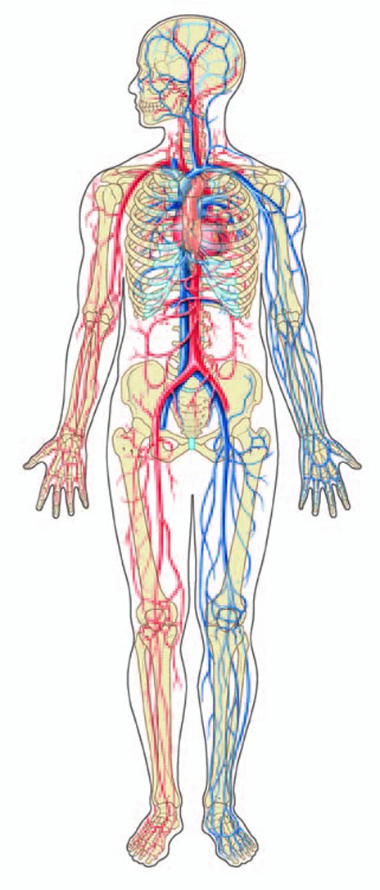
Blood Vessels

Slide 3
Our Goals Today...
Explain the difference between the five types of blood vessels.
Arteries, Veins, Arterioles, Venules and Capillaries
Identify and give the function (including where the vessel is carrying blood from and where it is carrying blood to) of each major blood vessel

Slide 4
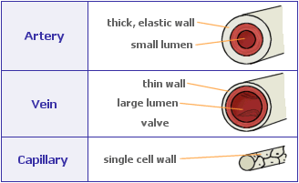
Blood Vessels
http://www.scienceunleashed.ie/GenImage.aspx?id=1094

Slide 5
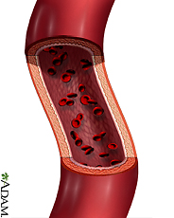
Arteries
Thick, elastic walls
Located deep, along bones
Carry blood ___________ from the heart
Most carry _______________ blood to the body’s tissues (systemic circuit)
Only 1 artery in the body carries deoxygenated blood – the _______________ ________(pulmonary circuit)
Arteries are able to expand to receive blood from the heart (pulse)
http://www.nlm.nih.gov/medlineplus/images/artery.jpg

Slide 6
Arteries
Thick, elastic walls
Located deep, along bones
Carry blood AWAY from the heart
Most carry oxygenated blood to the body’s tissues (systemic circuit)
Only 1 artery in the body carries deoxygenated blood – the pulmonary artery (pulmonary circuit)
Arteries are able to expand to receive blood from the heart (pulse)
http://www.nlm.nih.gov/medlineplus/images/artery.jpg

Slide 7
Veins
Thin walled vessels with ____________
Usually located near the surface surrounded by skeletal muscles
Carry blood ___________ to heart
Most carry ____________________blood (systemic circuit)
Only veins in the __________
____________ carry oxygenated blood
Valves prevent blood from flowing backwards
http://www.adronline.org/images/evlt/blueVein.gif

Slide 8
Veins
Thin walled vessels with valves
Usually located near the surface surrounded by skeletal muscles
Carry blood BACK to heart
Most carry deoxygenated blood (systemic circuit)
Only veins in the pulmonary circuit carry oxygenated blood
Valves prevent blood from flowing backwards
http://www.adronline.org/images/evlt/blueVein.gif

Slide 9
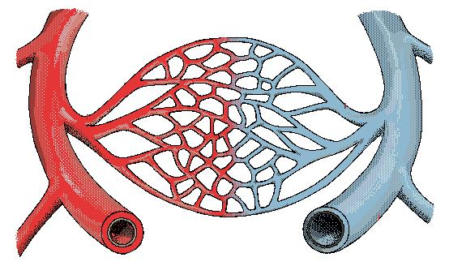
Capillaries
Very thin walled vessels
Connect arteries and veins
Located everywhere!
So small that blood cells can only move through them one at a time
http://www.biotech.iitm.ac.in/faculty/annlabweb/capillary%20network.JPG

Slide 10
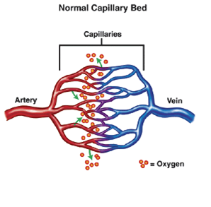
Other Vessels
Arterioles
Small arteries
Some that lead to specific organs that have sphincter muscles (to regulate blood pressure and flow to organ)
Venules
Small Veins
http://neuro.wehealny.org/images/12_02.gif

Slide 11
Major Blood Vessels
Aorta
Coronary Arteries and Veins
Carotid Arteries
Jugular Veins
Subclavian Arteries and Veins
Mesenteric Arteries
Hepatic Portal Vein
Hepatic Vein
Renal Arteries and Veins
Iliac Arteries and Veins
Anterior and Posterior Vena Cava
Pulmonary Veins and Arteries
Know these major vessels and where they are transporting blood to and from.

Slide 12
Blood Vessels
Arteries
Venules
Capillaries
Arterioles
Veins

