Slide 1
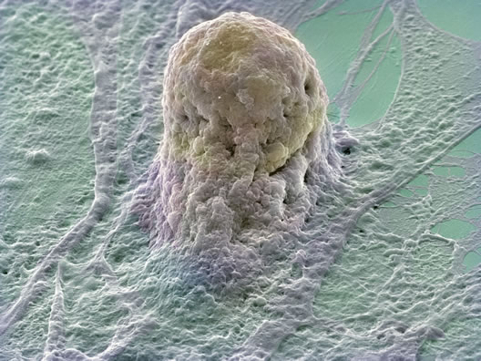
Cell Structure
Electron micrograph of a human embryonic stem cell.
http://www.wellcome.ac.uk/en/bia/gallery.html?image=13

Slide 2
Cells: The Building Blocks of Living Organisms
Prokaryotic Cells
Eukaryotic Cells
Simple cells
Lack membrane bound organelles
Bacteria Cells
More complex cells
Contain membrane bound organelles
Animal Cells
Plant Cells
Fungi Cells

Slide 3
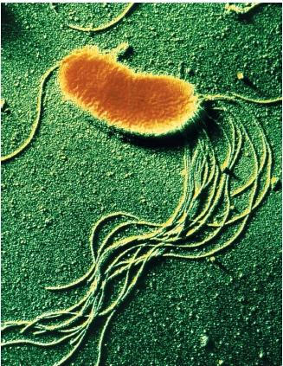
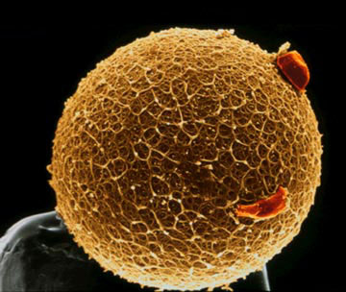
Cells: The Building Blocks of Living Organisms
Prokaryotic Cells
Eukaryotic Cells
http://www.scienceclarified.com/images/uesc_02_img0068.jpg
http://www.sciencemuseum.org.uk/on-line/lifecycle/45.asp

Slide 4
Eukaryotic Cells
Compartmentalized
Organelles:
Parts of a cell
each having a unique structure and
function
ALL contribute to the overall
functioning of the cell

Slide 5
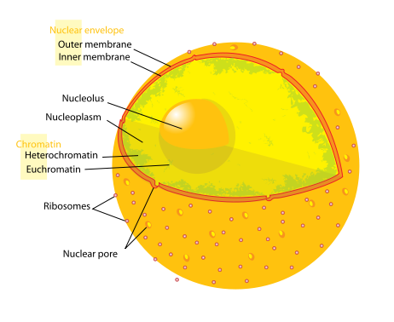
Nucleus
Nucleoplasm
Nuclear Envelope
with pores
Chromatin
Nucleolus –
make ribosomes
http://commons.wikimedia.org/wiki/File:Diagram_human_cell_nucleus.svg

Slide 6
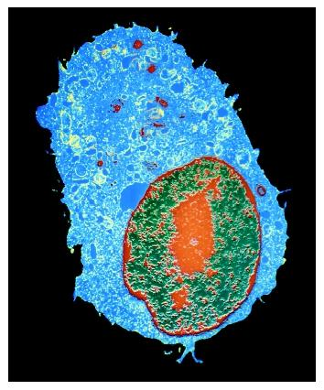
Nucleolus
Visible region in the nucleus
Here RNA and proteins combine to form RIBOSOMES
http://www.biologyreference.com/images/biol_03_img0316.jpg

Slide 7
Ribosomes
Location of protein synthesis.
Proteins made in the cytoplasmic ribosomes generally stay in the cell.
Proteins made on the ER usually leave the cell.
Polysomes

Slide 8
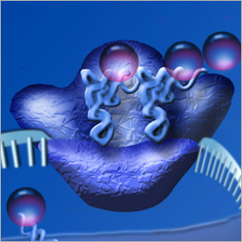
Ribosomes
Ribosomes leave the nucleus through the nuclear pores
Some become embedded in the Endoplasmic Reticulum (ER)
Others remain in the
cytoplasm of the cell
http://www.nsf.gov/news/overviews/biology/interactive.jsp

Slide 9
Endoplasmic Reticulum
Rough ER (RER)
Smooth ER (SER)
Ribosomes embedded in its membranes
Act to move molecules throughout the cell
Role in making phospholipids
No ribosomes
Act to move molecules throughout the cell
Location of steroid production

Slide 10
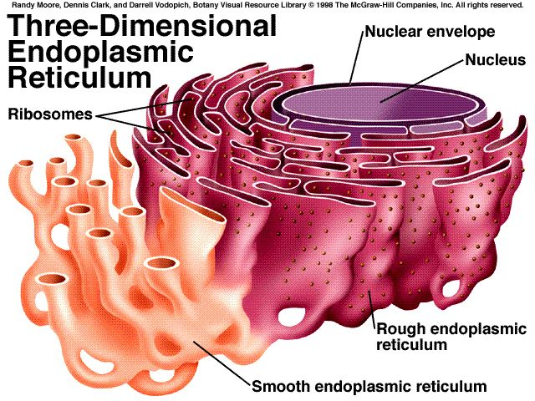

Slide 11
Vesicles
Both types of ER produce vesicles through budding (aka blebbing)
Vesicles are small membrane bound sacs
Contain biochemicals produced in the ER
These transition vesicles move from the ER to the Golgi apparatus (aka Golgi bodies)

Slide 12
Golgi Bodies
Look similar to Smooth ER
Made of 7 or 8 flattened saccules
Generally located between the ER and the cell membrane

Slide 13
Golgi Bodies
Molecules are often modified by Golgi Bodies
New vesicles bud off of the Golgi containing modified molecules
These vesicles are called Secretory Vesicles
Secretory vesicles head to the cell membrane and contents are secreted through exocytosis
Golgi Bodies also form Lysosomes used to digest molecules in the cell (hydrolysis)

Slide 14
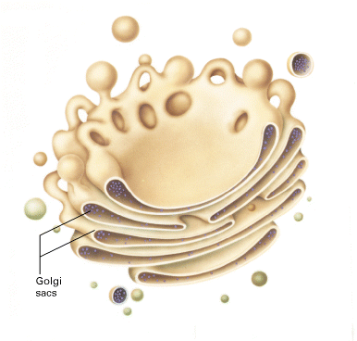
Vesicles and the Golgi Bodies
Secretory Vesicles
Transition Vesicles from the ER
http://tainano.com/Molecular%20Biology%20Glossary.files/image107.gif

Slide 15
Mitochondria and Chloroplasts
Fluid-filled with complex internal membranes
Both organelles have energy related chemical reactions occurring within them

Slide 16
Mitochondria
Exist in almost every cell
Conduct respiration in which carbohydrates are used to create ATP (chemical energy) on the cristae of these organelles
Respiration:
C₆H₁₂O₆ + 6O₂ → 6CO₂ + 6H₂O + 38ATP

Slide 17
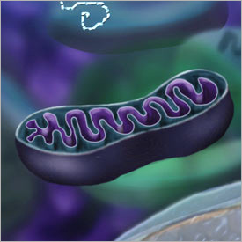
Mitochondria
http://www.nsf.gov/news/overviews/biology/interactive.jsp

Slide 18
Chloroplasts
Only present in plant cells
Contain Chlorophyll – a pigment that allows plants to photosynthesize

Slide 19
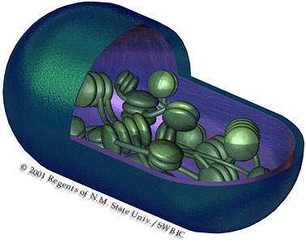
Chloroplasts
http://www.compulink.co.uk/~argus/Dreambio/photosynthesis/photosynthesis%201.htm

Slide 20
Other Important Cell Structures
Cytoplasm
Cytoskeleton
Lysosomes
Vacuoles
Cell Membrane
Cell Wall
Cilia and Flagella

Slide 21
Golgi Apparatus
Mitochondria & Chloroplasts
Cytoskeleton
Ribosomes
Cell Membrane
Smooth & Rough ER
Vesicles
Cytoplasm
Lysosomes
Cell Parts
Vacuoles
Nucleus

Slide 22
More Information
Take this tour of the cell:
http://www.nsf.gov/news/overviews/biology/interactive.jsp

