Slide 1
Enzymes
Key to Metabolism

Slide 2
Goal this Section...
Analyse the roles of enzymes in biochemical reactions

Slide 3
Metabolism
All biochemical processes in the body
Ex. Food digestion, Blood Clotting, DNA Replication....etc.
Enzymes catalyze these reactions
Thyroxin – hormone produced by the thyroid that governs the rate of cell metabolism

Slide 4
Enzyme Function
Functional proteins
Enzymes do not function independently, typically have 3 parts:
Apoenzyme (protein portion)
Coenzyme (vitamin portion)
Co-factor (mineral ion)

Slide 5
Enzyme Reactions
2H⁺
Succinic Acid Hydrogenase
Succinic
Acid
Fumaric Acid
To write a biochemical reaction
write the name of the enzyme on (or under) the arrow
use curved arrows to show by-products on the right side of the equation.

Slide 6
Enzyme Function
Enzyme-catalyzed reactions do not often occur without enzymes
Enzymes are specific to reactions
Protein is the functional part of an enzyme
Energy of an enzyme-catalyzed reaction is different from the same reaction without enzyme

Slide 7
Enzyme Function
Substrate is the molecule that reacts with an enzyme
Ex. Succinic Acid:
Enzymes end in -ase
2H⁺
Succinic
Acid
Succinic Acid Hydrogenase
Fumaric Acid

Slide 8
Lock and Key Fit
Enzymes have 3-D tertiary structure made of specific amino acids
This allows them to bind to a specific substrate:
Therefore enzymes and substrates are said to fit together like a lock and key!
Enzyme + Substrate
Activated E-S Complex
Enzyme + Product

Slide 9
Lock and Key Fit
Just like a key, once finished the enzyme is freed and can be used again
Shape is critical
Part of the enzyme that is involved in the reaction is called the ACTIVE SITE
If the wrong key (substrate) fits into a lock (enzyme) it won’t work!

Slide 10
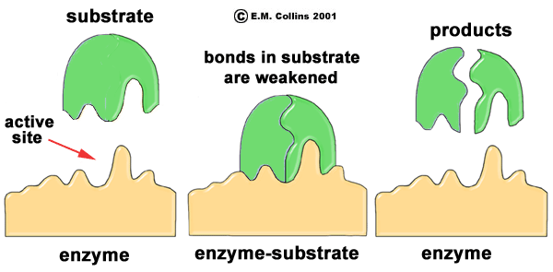
Lock and Key Fit
http://waynesword.palomar.edu/images/enzyme5.gif

Slide 11
Homework:
Define and provide examples of catabolism and anabolism
Describe the induced fit hypothesis.
What does it mean for an enzyme to be part of a metabolic pathway?

Slide 12
Energy Concerns
Activation Energy – energy required for the reaction to occur (ATP)
Exothermic and Endothermic Reactions

Slide 13
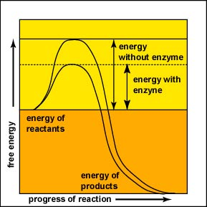
Energy Concerns
http://student.ccbcmd.edu/~gkaiser/biotutorials/proteins/images/u4fg3a.jpg

Slide 14
Factors Affecting Enzymes
Temperature
pH
Heavy Metal Ions
Inhibitors
Concentration

Slide 15
Temperature
Protein structure is very sensitive to temperature (Ex. Cooked egg white)
Optimum temperatures
Human body this temperature is around 37˚C
Notes:
People will hypothermia who have temperatures as low as 17 degrees have been revived because proteins can sometimes renature (to regain structure and therefore function).

Slide 16
Temperature
As temperature increases above 37˚C enzyme function decreases (a fever of 50˚C is lethal because proteins may denature)
If temperature decreases below 37˚C enzymes function also decreases because of lower kinetic energy (hypothermia)
Notes:
People will hypothermia who have temperatures as low as 17 degrees have been revived because proteins can sometimes renature (to regain structure and therefore function).

Slide 17
pH
Optimal pH
Outside of this optimal pH enzymes denature
Ex. Stomach enzymes → pH 2
Small Intestine → pH 8.5
Blood → pH 7.2
Body has systems in place to maintain pH so enzymes function at their best

Slide 18
Heavy Metals Ions
Ions of metals like mercury and lead have a greater affinity for electrons compared to molecules in living organisms
In the presence of enzymes these metals tend to alter their shape and inhibit their function
Heavy metals are considered non-competitive inhibitors

Slide 19
Inhibitors
Two types of inhibitors that prevent enzymes from binding to substrates:
Competitive Inhibitors
Non-competitive inhibitors (Allosteric Competitor)
Competitive Inhibitors: occupy the active site of an enzyme preventing the reaction from occurring
Non-competitive Inhibitors: binds to another area on the enzyme which changes its shape therefore preventing the substrate from binding to the enzyme

Slide 20
Concentration
Substrate Concentration
Enzyme Concentration
As the amount of substrate in a cell increases so does the rate of reaction
The rate of reaction will continue to increase until all enzymes are in use
The amount of enzyme available in the cell will impact the rate of reaction in the same way that the concentration of substrate does

Slide 21
Enzymes
Metabolism
Specific relationship between enzyme and substrate
Factors Affecting Enzymes
Temperature
pH
Lock and Key
Enzyme Function
Biochemical processes
Catalyze reactions
Proteins
Substrates
Inhibitors
Concentration

