Slide 1
Reproductive System

Slide 2
Overview
Introduction
Male Reproductive System
Female Reproductive System
Implantation, Pregnancy and Childbirth

Slide 3
Introduction
Male and Female systems are homologous
Gonads
Gamete producing organs
Ovaries - internal
Testes – external
Testes descend through abdominal cavity into the scrotum through the inguinal canal
Tubes (or ducts)

Slide 4
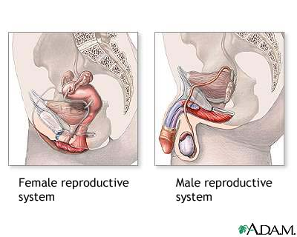

Slide 5
Male Reproductive System

Slide 6
Our Goals this Section...
Identify and give functions for each of the following:
testes (seminiferous tubules and interstitial cells)
scrotum
epididymis
ductus (vas) deferens
prostate gland
Cowper’s glands
seminal vesicles
penis
Urethra
Describe the path of sperm from the seminiferous tubules to the urethral opening
List the components seminal fluid (as contributed by the Cowper’s glands, prostate gland, and seminal vesicles), and describe the functions of each component
Identify the tail (flagellum), midpiece, head, and acrosome of a mature sperm and state their functions
Describe the functions of testosterone
Describe the homeostatic regulation of testosterone levels by the hypothalamus, anterior pituitary, and testes

Slide 7
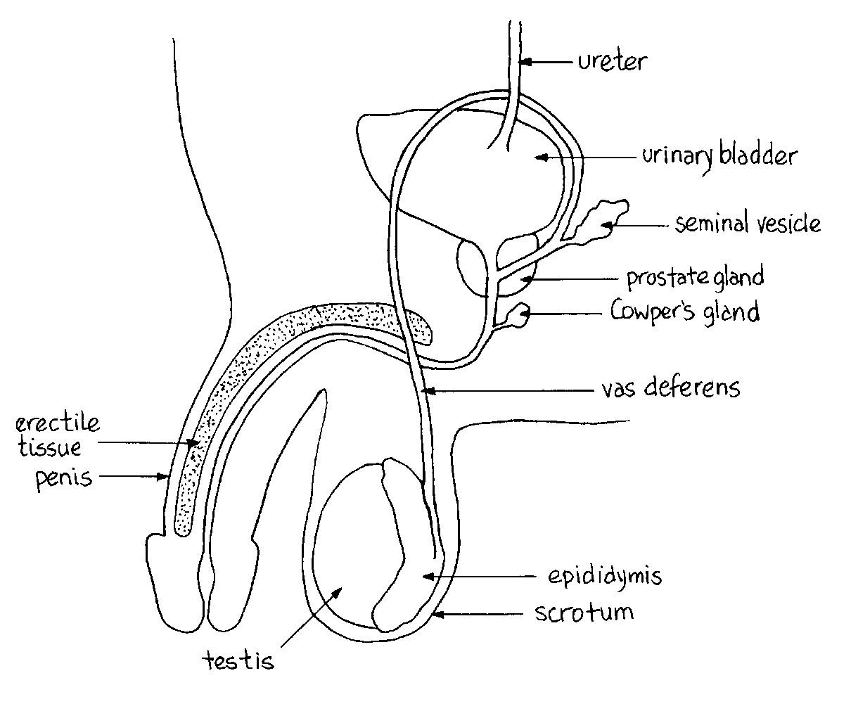
External Anatomy
Scrotum (contain testes)
Penis

Slide 8
Spermatogenesis
Sperm Production
Made in the SEMINIFEROUS TUBULES
Germ layer
Unspecialized cells that line the seminiferous tubules
Continuously undergo mitosis to make sperm
Every time a cell undergoes mitosis it produces 2 cells
1 cell stays in the germ layer
1 cell will move to the inner wall of the tubule and will divide by meiosis to eventually become sperm cells

Slide 9
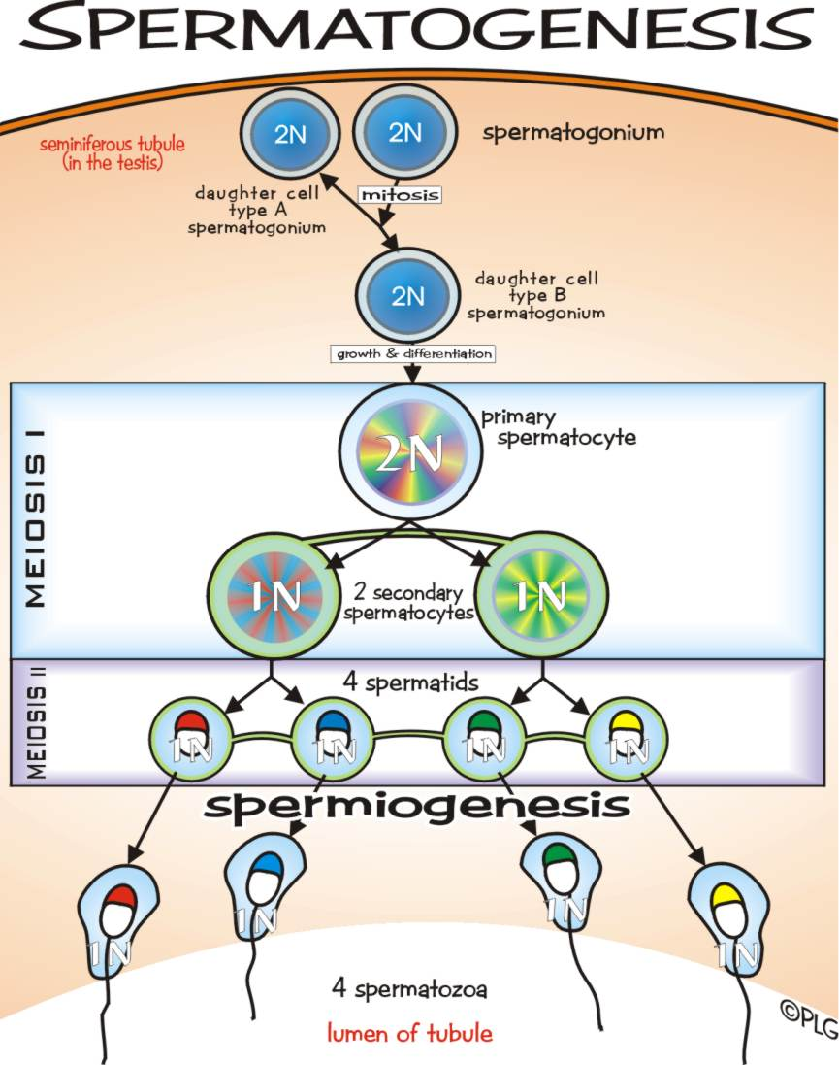

Slide 10
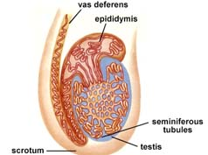
Spermatogenesis
Tubes of the seminiferous tubules join together forming the epididymis
Sperm cells continue to mature as they move from the seminiferous tubules to the epididymis
Following the epididymis, the cells enter the vas (or ductus) deferens for final development
Sperm gain their swimming ability in these regions
Epididymis
Vas Deferens

Slide 11
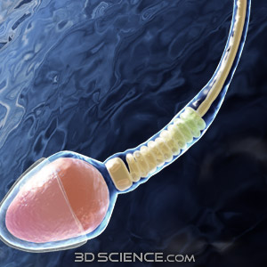
Spermatogenesis
Sperm production takes a few days
Process is ongoing after puberty
Millions of sperm develop every day

Slide 12
Sperm
3 regions
Head
DNA - 23 chromosomes
Enclosed in the acrosome (gel-like layer)
Midpiece
Mitochondria for ATP production
Tail
Flagellum for locomotion

Slide 13
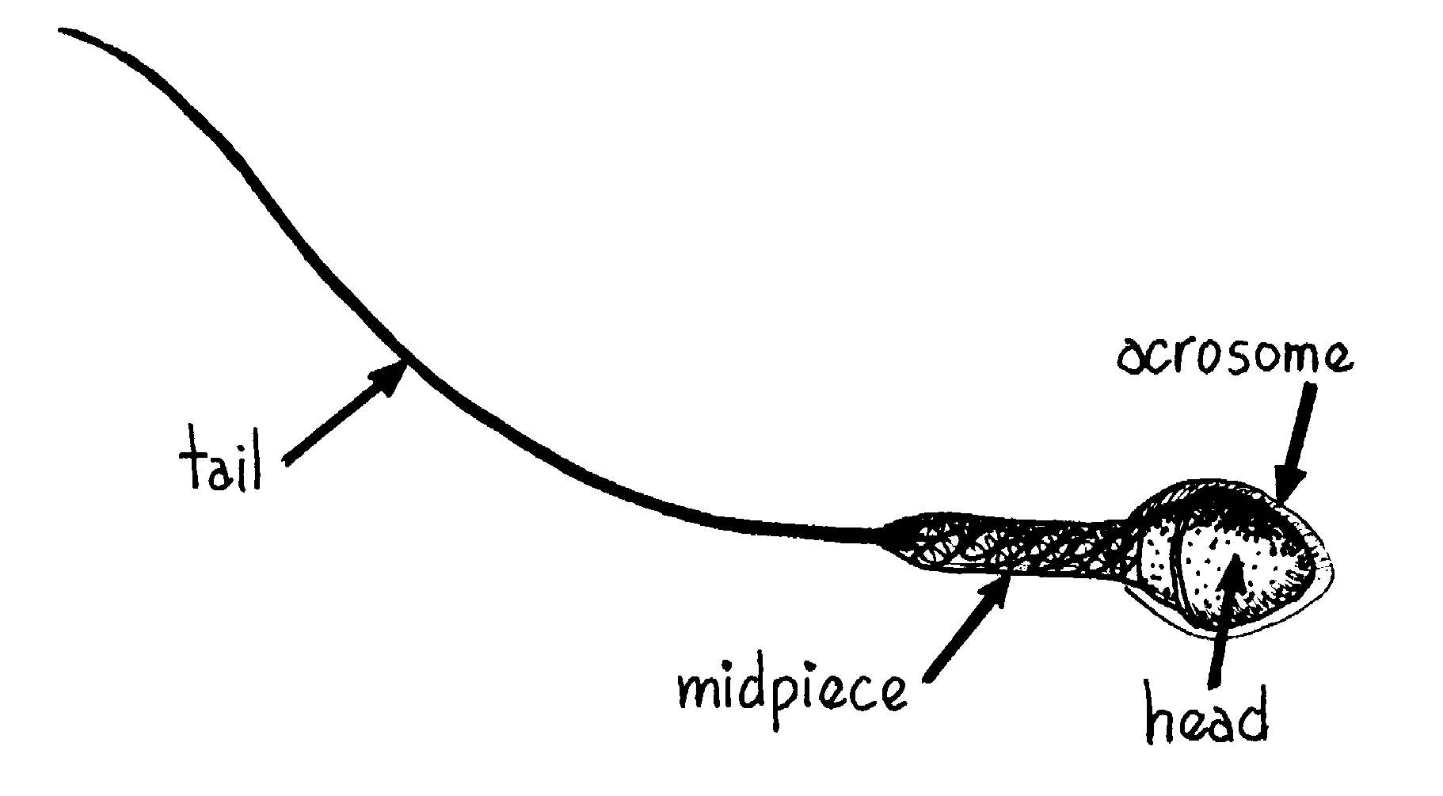

Slide 14
Penis
Organ of Copulation (sexual intercourse)
Erectile tissue and urethra
Carries both sperm and urine
When aroused the arteries of the penis dilate and the vein constrict
Engorges the erectile tissue with blood making the penis erect
Angle allows the sperm to enter the urethra

Slide 15
Semen
Sperm & Seminal Fluid
Seminal Fluid
Milky white solution
Made by 3 glands – seminal vesicles, the Cowper’s gland and the prostate gland
pH of 7.5
Contain fructose for nutrition
HCO₃ ⁻ for a buffer
Prostaglandins (promote uterine contractions following intercourse)

Slide 16
Semen
As it enters the urethra it encourages the rhythmic contractions which lead to ejaculation
Sphincter at the base of the bladder prevents urine from entering the urethra at this point
After ejaculation penis is flaccid
Refractory period

Slide 17
Endocrine Tissue
Interstitial cells between the seminiferous tubules
Secrete male sex hormones called androgens
Eg. Testosterone
Primary sex organ development
Secondary sex characteristics associated with puberty
Secondary Sex Characteristics include:
Ancillary hair growth
Enlargement of larynx
Muscle & skeletal growth
Release of oils & sweat (acne and BO)
Baldness
Adrenal Cortex also produces androgens which contribute to muscle mass and strength (both men and women)

Slide 18
Puberty
Hypothalamus begins producing gonadotrophic releasing hormones (GnRHs) to the anterior pituitary gland
Stimulates the sexual functions of the testes
Anterior pituitary responds by producing two hormones
Lutenizing hormone (LH) – AKA interstitial cell stimulating hormone (ICSH)
Follicle stimulating hormone (FSH)
LH promotes interstitial cells to produce testosterone
FSH promotes sperm maturation

Slide 19
Feedback Control of Testosterone
LH from the anterior pituitary promotes testosterone release from the interstitial cells of the testes
Testosterone levels decrease the amount of LH
Therefore the levels of testosterone are maintained
Negative feedback

