Slide 1
Nervous System
Mounting responses to changes in the environment.

Slide 2
Our Goals Today...
Compare the locations and functions of the central and peripheral nervous systems
Identify and give functions for each of the following parts of the brain:
medulla oblongata
cerebrum
thalamus
cerebellum
hypothalamus
pituitary gland
corpus callosum
meninges
Explain how the hypothalamus and pituitary gland interact as the neuroendocrine control centre

Slide 3
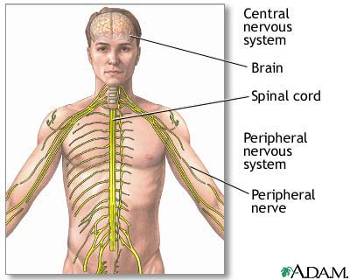
Nervous System
Central Nervous System
Peripheral Nervous System
CNS
Brain and Spinal Cord
PNS
Nerves that extend from the CNS to collect stimuli
Conduct impulses from the CNS
Nerves are either autonomic nervous system (involuntary) or somatic nervous system (voluntary)

Slide 4
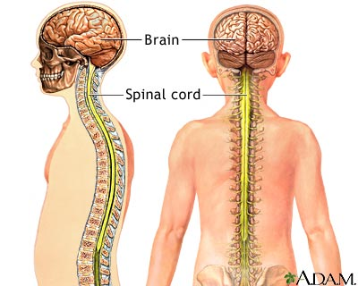
Central Nervous System: Brain

Slide 5
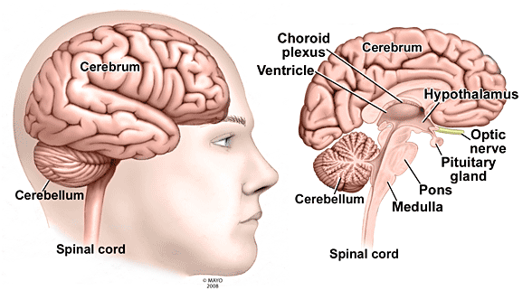
Brain starts to develop in embryos
Cranial Nerves: 12 pairs of nerves that extend from the brain (PNS)

Slide 6
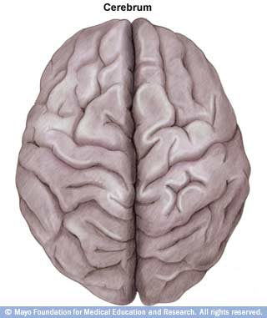
Cerebrum
Largest part of the brain
Divided into the right and
left hemispheres by the
central fissure
Corpus Callosum
area of dense tissue at the
base of the central fissure

Slide 7
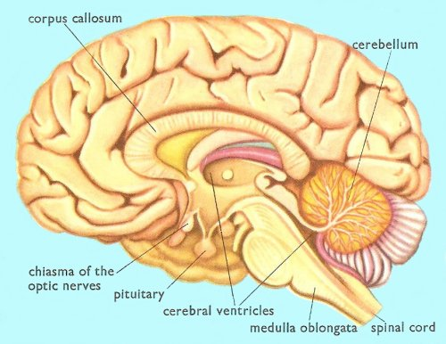
Cerebrum

Slide 8
Cerebrum
Central processing area
Memory storage
Conscious thoughts are made here
Non-reflexive connections and associations are made here
Subdivided into lobes which are further divided into areas with specialized functions
Handles impulses that require processing before responses are sent (eg. Moving in response to a visual stimuli)

Slide 9
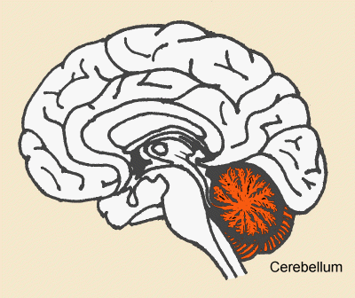
Cerebellum

Slide 10
Cerebellum
Ensures muscles coordination and balance
Sensory information is constantly being sent from the periphery to the brain
Including information about the body’s spatial orientation
Routed through the cerebellum
Ensured that motor impulses coming from the cerebrum allow for smooth movement and balance

Slide 11
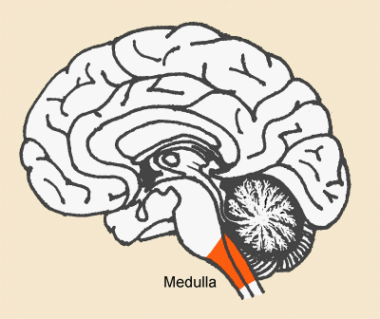
Medulla Oblongata

Slide 12
Medulla Oblongata
Located in the brain stem at the top region of the spinal cord
Receptors that are sensitive to conditions in the blood (CO₂ and H⁺)
Responsible for various functions that don’t require conscious thought (eg. heart rate and breathing rate)
Reflexive action
Coughing, sneezing, hicupping, vomiting, swallowing

Slide 13
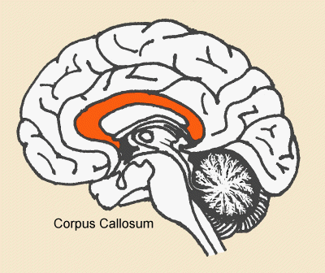
Corpus Callosum
Coordinates impulses from 1 side of the brain to the other

Slide 14
Thalamus
Under the corpus callosum and inside a ventricle of the brain
Impulses travelling from the spinal cord pass through the thalamus
Directs impulses to the correct part of the cerebrum
“Sorting Center”

Slide 15
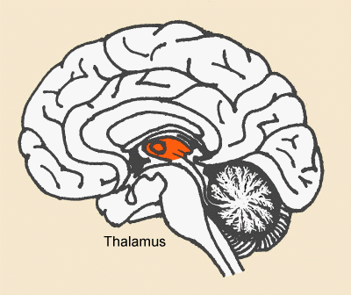
Thalamus

Slide 16
Hypothalamus
Below the thalamus
Responsible for homeostasis (body temperature, sleep, hunger, thirst, etc)
Constantly sampling the blood that travels through it
Responds through nerve impulses or hormones
Hormones are produced by the pituitary gland

Slide 17
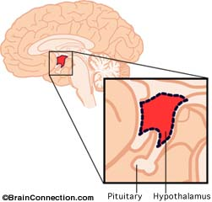
Hypothalamus

Slide 18
Central Nervous System: Spinal Cord

Slide 19
Extends from brain through the vertebrae
Nerves extend from the spinal cord between vertebrae

Slide 20
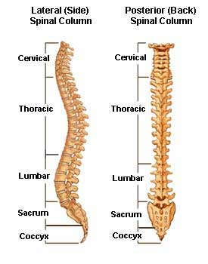

Slide 21
Protecting the Nervous System
CNS is surrounded in bone
Skull protects brain
Vertebrae protect spinal cord
Meninges is a set of membranes that protects the nervous tissue from the rough bone
Dura Mater (closest to bone)
Arachnoid Layer
Pia Mater (closest to nervous tissue)

Slide 22
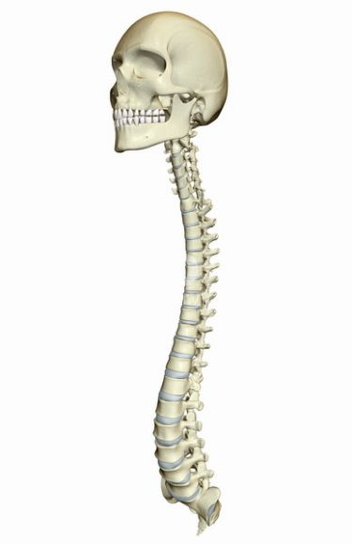
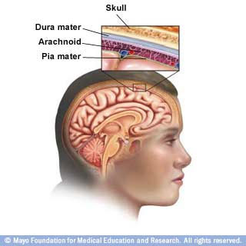

Slide 23
Remember Our Goals Today...
Compare the locations and functions of the central and peripheral nervous systems
Identify and give functions for each of the following parts of the brain:
medulla oblongata
cerebrum
thalamus
cerebellum
hypothalamus
pituitary gland
corpus callosum
meninges
Explain how the hypothalamus and pituitary gland interact as the neuroendocrine control centre

