Slide 1
Nervous System
Impulse Transmission
Saltatory Impulse Transmission
Synaptic Transmission
Sympathetic vs Parasympathetic Systems

Slide 2
Our Goals Today...
Explain the transmission of a nerve impulse through a neuron, using the following terms:
resting and action potential
depolarization and repolarization
refractory period
sodium and potassium gates
sodium-potassium pump
threshold value
“all-or-none” response
Polarity
Relate the structure of a myelinated nerve fibre to the speed of impulse conduction, with reference to myelin sheath, Schwann cell, node of Ranvier, and saltatory transmission

Slide 3
Impulse Transmission
Transmission of an impulse along a neuron requires ion movement
Changes the electrical nature of fiber
Studied extensively in the axons of motor neurons – applies to all nerve cells

Slide 4
Resting Potential
Neuron at rest
Na⁺ is abundant outside the axon
K⁺/negative ions abundant inside the axon
Axomembrane (membrane of the axon) – is not permeable to these ions at rest
Axoplasm has a slight negative charge normally (-65mV)
Axomembrane has Na/K pumps

Slide 5
Depolarization
A stimulus is past threshold
Axomembrane becomes permeable to Na⁺
Na⁺ floods into the axoplasm through sodium gates
Axoplasm becomes positive (+40mV)

Slide 6
Repolarization
Causes the Na⁺ to close and the K⁺ gates to open
K⁺ floods out – restores original electrical charge (repolarization)
Na/K pumps then operate to return ions to their original locations

Slide 7
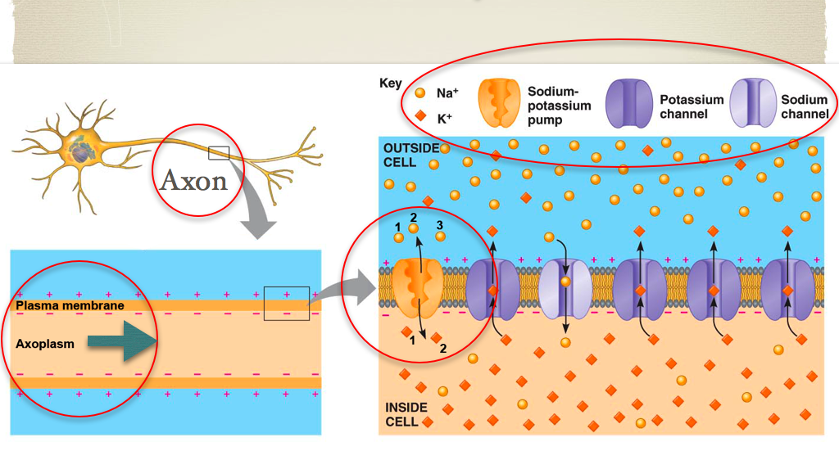

Slide 8
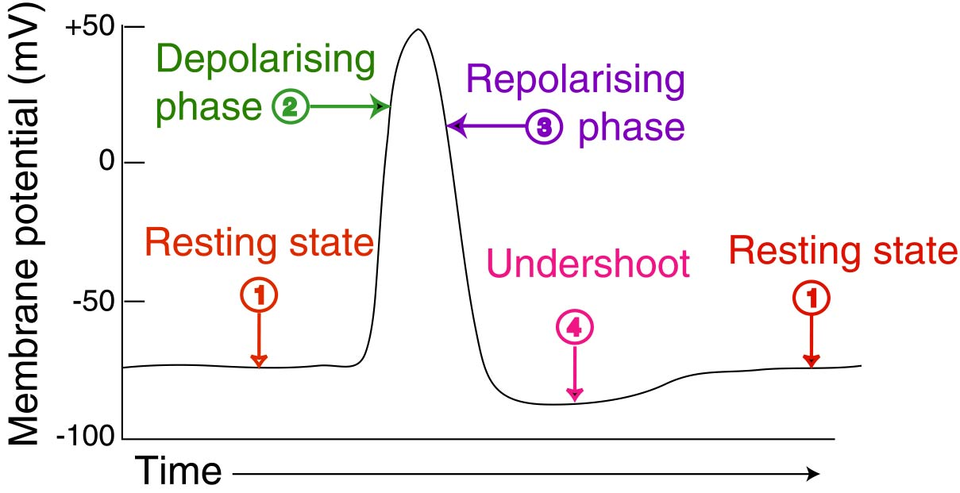

Slide 9
http://highered.mcgraw-hill.com/sites/0072495855/student_view0/chapter14/animation__the_nerve_impulse.html

Slide 10
Impulse Transmission
Magnitude of electrical charges is always the same
Impulses are ALL-or-NONE
Strong stimulus ≠ bigger impulse
Strong stimulus = more impulses

Slide 11
Saltatory Impulse Transmission
Ionic movement in one axon results in adjacent regions on other nerve fibers to undergo the same changes
Therefore impulse moves along to the next fiber
Myelin sheath limits this from happening however the impulse will “jump” between neuron fibers at nodes of Ranvier therefore speeding up the impulse = SALTATORY

Slide 12
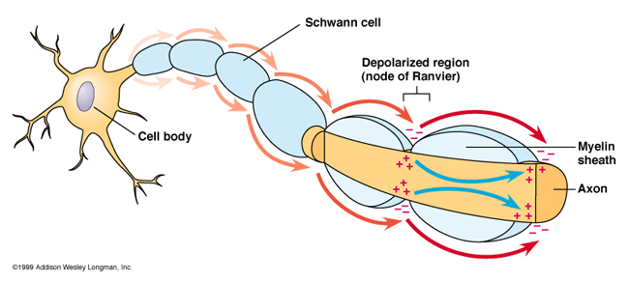

Slide 13
Remember our Goals...
Explain the transmission of a nerve impulse through a neuron, using the following terms:
resting and action potential
depolarization and repolarization
refractory period
sodium and potassium gates
sodium-potassium pump
threshold value
“all-or-none” response
Polarity
Relate the structure of a myelinated nerve fibre to the speed of impulse conduction, with reference to myelin sheath, Schwann cell, node of Ranvier, and saltatory transmission

Slide 14
Synaptic Transmission

Slide 15
Our Goals Today...
Identify the major components of a synapse, including
synaptic ending
presynaptic and postsynaptic membranes
synaptic cleft
synaptic vesicle
calcium ions and contractile proteins
excitatory and inhibitory neurotransmitters (e.g., norepinephrine, acetylcholine – ACh)
receptor
acetylcholinesterase (AChE)
Explain the process by which impulses travel across a synapse
Describe how neurotransmitters are broken down in the synaptic cleft

Slide 16
Synaptic Transmission
As an impulse arrives at the end of an axon it must be transmitted to the next nerve cell, muscle or gland
Terminus – axon ending
Specialized for transmission
Called a motor end plate when the receiving cell is a muscle cell
Terminus does not touch the membrane of the receiving cell
Space is called a SYNAPTIC GAP
Synaptic Transmission is the process of an impulse crossing this gap

Slide 17
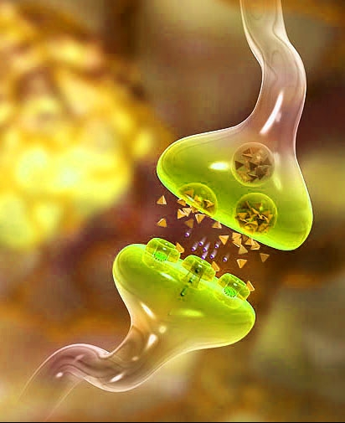

Slide 18
Synaptic Transmission
Pre-synaptic Membrane
Post-synaptic Membrane
Membrane at axon terminus
Contains Ca²⁺ gates
Encloses synaptic vesicles containing neurotransmitters
Membrane on the other side of the post synaptic gap
Contains protein receptor sites

Slide 19
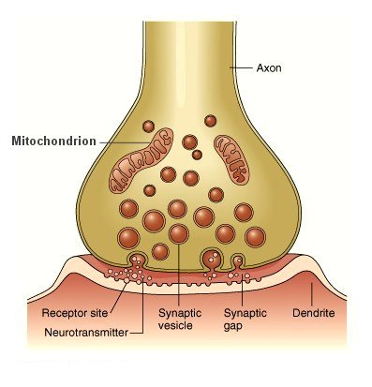

Slide 20
Synaptic Transmission
When an impulse arrives at the end of an axon depolarization occurs
Causes the Ca²⁺ gates to open
Ca²⁺ in the gap enters the axon
Ca²⁺ causes the vesicles of neurotransmitters to fuse with the pre-synaptic membrane
Exocytosis causes the neurotransmitter to be released into the synaptic gap

Slide 21
Synaptic Transmission
Neurotransmitters diffuse across the gap
Neurotransmitters bond with receptor sites on the post-synaptic membrane
This causes Na+ gates to open thus generating an impulse in the next cell
Synaptic gap contains enzymes that break down neurotransmitters restoring the synapse to its original condition

Slide 22
Synaptic Transmission
Ca²⁺ are transported back into the gap by ACTIVE TRANSPORT
Mitochondria in the axon supply energy for the entire process
Synaptic transmission only occurs in 1 direction because of the locations of vesicles, calcium gates and receptor sites

Slide 23
Neurotransmitters
Inhibitory
Excitatory
Makes it harder for depolarization to occur
Promotes depolarization
The overall effect of these neurotransmitters must pass a threshold value for sodium entry into the next cell before the impulse will be transmitted.

Slide 24
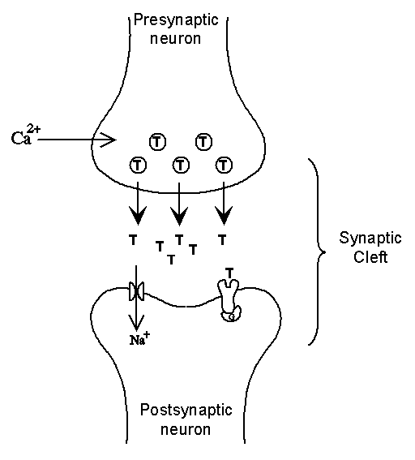

Slide 25
Remember Our Goals...
Identify the major components of a synapse, including
synaptic ending
presynaptic and postsynaptic membranes
synaptic cleft
synaptic vesicle
calcium ions and contractile proteins
excitatory and inhibitory neurotransmitters (e.g., norepinephrine, acetylcholine – ACh)
receptor
acetylcholinesterase (AChE)
Explain the process by which impulses travel across a synapse
Describe how neurotransmitters are broken down in the synaptic cleft

Slide 26
You are Finishing Today’s Notes:
Differentiate between the functions of the autonomic and somatic nervous systems
Describe the inter-related functions of the sympathetic and parasympathetic divisions of the autonomic nervous system, with reference to
effect on body functions including heart rate, breathing rate, pupil size, digestion
neurotransmitters involved
overall response (“fight or flight” or relaxed state)
Identify the source gland for adrenalin (adrenal medulla) and explain its role in the “fight or flight” response

