Slide 1
Unit 1 Reaction Kinetics
Chemistry 12

Slide 2
Introduction
Movement of particles in chemical reactions
Use reaction times and changes in MEASURABLE properties to measure the rate of reactions
Use previous knowledge to create theories that explain and predict rates of reaction

Slide 3
Measuring Reaction Rates
How a property changes per unit of time
The property must be both observable and measurable.

Slide 4
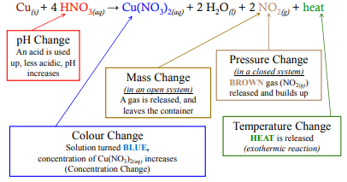
Example

Slide 5
Units
Always expressed as per unit of time
Many possible units
Any unit of time can be used, just pick one that is appropriate!
Make a list of possible units from the previous example:

Slide 6
Try These!
If ethane is consumed at a rate of 0.066 mol /s, calculate the rate of consumption of O₂ in mol /s? 2C₂H₆ + 7O₂ → 4CO₂ + 6H₂O
If 67.5 g of Al are consumed per second - calculate the rate of consumption of Br₂ in g/s.
2Al + 3Br₂ → 2AlBr₃
***** When in doubt mole it out *****

Slide 7
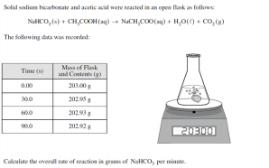
Answer: -0.1 g/min NaHCO₃

Slide 8
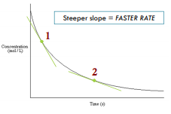
Graphing
The rate is the slope of a property vs time graph. Here is a graph of the reaction between hydrofluoric acid and potassium cyanide. The concentration of HF is on the Y-axis
What do you notice about the graph at
Point 1 and Point 2?

Slide 9
Exercises
Hebden Student Workbook (Textbook)
pg 2 #1-5
pg 3 #6
pg 5 #7-9

Slide 10
What Factors affect Reaction Rate?
When making chocolate milk, does the powder dissolve faster in hot milk or cold milk?
When magnesium metal is placed in equal volumes of hydrochloric acid, will the reaction be fast in 3.0M HCl or 6.0M HCl?

Slide 11
Factors that Affect Reaction Rate
Temperature
Pressure and Concentration
Surface Area and Phase
Nature of Reactants
Inhibitors and Catalysts
Instructions
Complete the summary worksheet
Pg 7 #10-11
Pg. 8/9 # 12-16

Slide 12
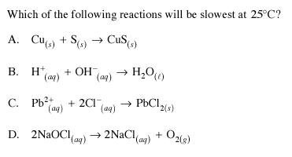
Try this one!

Slide 13
Collision Theory
For a reaction to occur a chemical atom, molecule, or ion must:
Collide with sufficient energy
Collide with the correct alignment

Slide 14
Question
How could collision theory be used to explained how an increase in temperature increased the reaction rate? How about concentration?
Complete questions 20-22 on page 12

Slide 15
Energy in Chemical Reactions
Enthalpy (H) – total kinetic and potential energy of a system under constant pressure
Potential Energy
stored form of energy
results from the position of the object in space and the sum of its attractive and repulsive that make up the object
Kinetic Energy – energy related to the motion of the an object

Slide 16
Change in Enthalpy (∆H)
∆H = H_{products} – H_{reactants}
Where Hproducts = the total enthalpy of the products
And Hreactants = the total enthalpy of the reactants
How does ∆H relate to endothermic and exothermic?

Slide 17
 | Endothermic | Exothermic
∆H
Thermochemical Equation
Graph
Heat of System vs Surroundings
Other

Slide 18
Exercises
Read pages 13-16
Exercises 24-28 on page 16

Slide 19
Kinetic Energy Distributions
The average kinetic energy of a system is connected to its temperature
For example for the reaction:
At room temperature this reaction happens very slowly
At 200˚C the reaction is still slow
But at 400˚C the reaction is quite fast

Slide 20
Lets explain this in terms of Kinetic Energy
You will notice in the graph to the right, that some molecules have lots of kinetic energy while some have little.

Slide 21
When the temperature is increased it increases the average KE of the entire System

Slide 22
Use the previous Slide to Make some Conclusions
At 25˚C
At 200˚C

Slide 23
Use the previous Slide to Make some Conclusions
At 400˚C
Overall
Rate is increase due to temperature is not due just to increase collisions, but also to an overall increase in the number of molecules that have the minimum energy to react.
In general for a slow reaction: A 10˚C INCREASE IN TEMPERATURE WILL DOUBLE THE REACTION RATE

Slide 24
exercises
Pg. 19 # 29-32

Slide 25
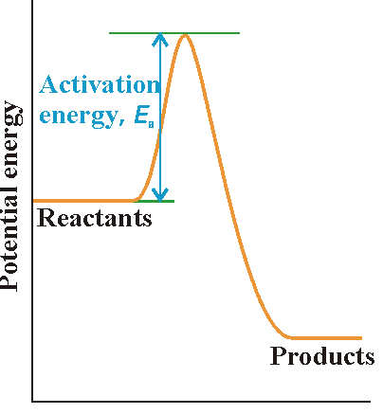
Activation Energy
This is the potential energy required for a
reaction to occur.
Keep this in mind:
KE + PE = Total Energy
The total energy always stays constant… so if the
KE goes down, what happens to the PE?

Slide 26
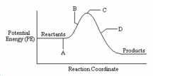
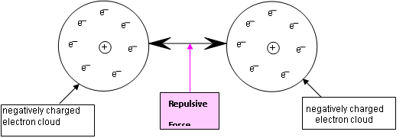
Activation Energy
A – Molecules
approach each
other, the like charges of
their electrons create
repulsive forces.

Slide 27
Activation Energy
B – Repulsive forces
slow the molecules
down.
This decreases the KE,
which is converted to PE!
If there is enough energy an Activated Complex is formed.

Slide 28
Activation Energy
C – Activated Complex
Highest PE
Intermediate particle
Activation Energy (Ea) is
the minimum energy required to convert the reactants into the activated complex
Bonds break and form

Slide 29
Activation Energy
D – new products form
Electrons in the
products outer shells
starts to repel
This forces them apart, PE gets converted to KE

Slide 30
Activation Energy Possibilities
PE < Ea
PE = Ea
PE > Ea

Slide 31
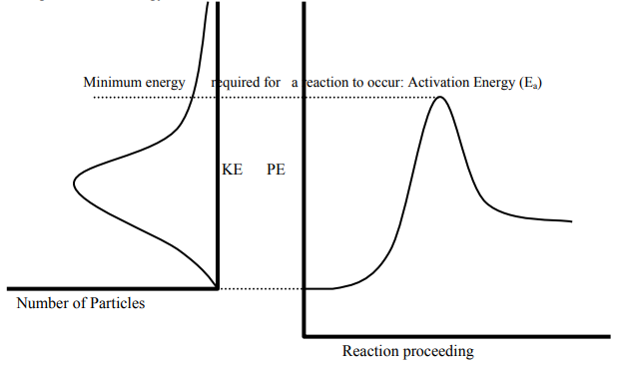
KE Distribution vs PE Diagram

Slide 32
In Conclusion
When two species collide there are two requirement which must be met:
Sufficient KE (to get converted to PE)
Correct Alignment (this ensure the lowest amount of energy is required.

Slide 33
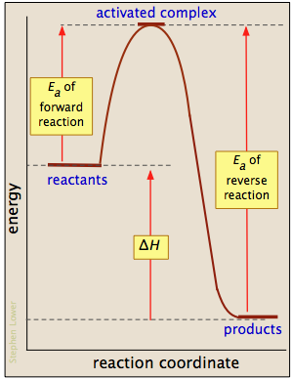
Brace YourSelf!!
Many reactions can go in the forward or REVERSE direction… this we will talk much more about in the next unit (Equilibrium).
For now, study this graph:
Note the Ea(r), Ea(f)
Is ∆H different?

Slide 34
Try this
Ea (forward rx.) = _________kJ
ΔH (forward rx. ) = _________kJ
This forward reaction is ______thermic
Ea (reverse rx.) = _________kJ
ΔH (reverse rx. ) = _________kJ
This reverse reaction is ______thermic

Slide 35
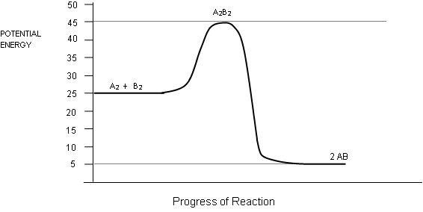
Another
Given the following Potential Energy Diagram for the Reaction: A₂ + B₂ → 2AB
Ea (forward) = KJ Energy needed to break bonds in A₂ & B₂ KJ
Ea (reverse) = KJ Energy needed to break bonds in AB (A-B) KJ
Which has the stronger bonds A₂ & B₂ or 2AB?
On a PE diagram, species with stronger bonds (more stable) are
(low/high) on the graph.
Which set of species (A₂ & B₂, A₂B₂, or 2AB) have the weakest bonds?
This species is the most stable. It is called the
_______________________ ___________________________
Which set of species has the highest PE?_________________________
Which set of species has the highest KE?_________________________
Draw a graph of KE vs. reaction proceeds for the same forward rxn.

Slide 36
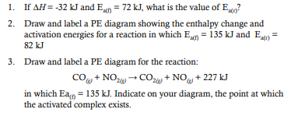
A few more ☺

Slide 37
Exercises
Pg. 23 #33-40
Pg. 25 #41-45

Slide 38
Reaction Mechanisms
The individual steps during a reaction
The odds of a reaction with more than two particles colliding with enough energy and the correct orientation is VERY LOW!
For example:
How many particles must come together for this reaction?
Therefore reactions must occur in a series of steps!

Slide 39
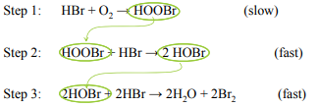
Sample Reaction
This reaction occurs in three steps:
Can you see how the overall reaction can be determined from its steps?

Slide 40
Notable Features of Reaction Mechanisms
The slowest step is the RATE DETERMINING STEP (RDS)
To find the overall reaction the steps can be added, and species that appear on both sides can be cancelled.
Those substances are produced and then react in later steps are called REACTION INTERMEDIATES. These will never be in the overall reaction. (eg. HOOBr, HOBr)
Note reaction intermediates are not the same as the activated complex
Finally, if there is a reactant that is introduced and is produced in a later step and can be cancelled… it is a CATALYST. Catalysts will not appear in the overall reactions.

Slide 41
Reaction Mechanism – PE Diagrams
Each step has a “bump” with its own activation energy and activation complex
Notice the slow step (RDS) has the highest PE!

Slide 42
Determining a Missing Step

Slide 43
Examples/Exercises
Three mechanism reaction
1.) A + 2X → AX₂
2.) AX₂ + X → AX + X₂
3.) AX + A → A₂ + X
Overall Rxn:____________________________________________
#46-55

Slide 44
The Effects of Catalysts
A substance that speeds up a chemical reaction
The catalyst lowers the activation energy with an alternation mechanism
This alternate pathway included different intermediate steps with a lower overall Ea.
∆H is the same, reaction rate increases

Slide 46
Forward and Reverse/Catalysts Everyday
Catalysts lower the Ea in both directions (forward and reverse)
Complete exercises pg. 34 #56-61
Read pg. 34-36 and complete #62
This marks the end of unit 1!!!

