Slide 1
Blood

Slide 2
Our Goal Today...
Describe the components of blood.

Slide 3
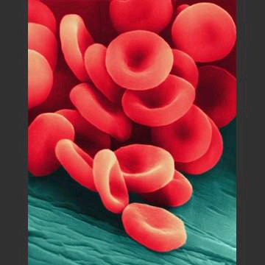
Blood
Complex tissue
Helps combat
infection
Regulates body
temperature
Transports gases,
nutrients and wastes to and from cells

Slide 4
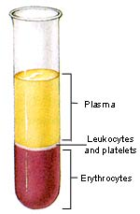
Blood Makeup
Plasma (55%)
- water and globulins (proteins)
Formed Elements (45%)
- blood cells

Slide 5
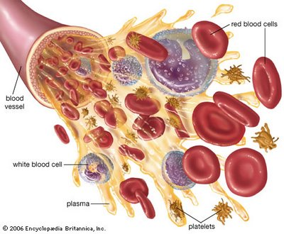
Blood Cells
Made in bone marrow
Similar parent stem cells mature in different ways to become a variety of blood cells
Red Blood Cells, White Blood Cells and Platelets
http://1.bp.blogspot.com/_v2GFIISzHOU/R-rA-3E5LrI/AAAAAAAAAIE/CPQCfmSLwR8/s400/Blood%2Bthat%2Bis%2Bnot%2Bjust%2Bred.jpg

Slide 6
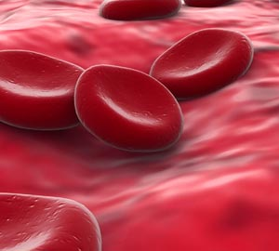
Red Blood Cells
Biconcave – lose their nuclei
Specialized for transport
Contain special proteins
(eg. Hemoglobin)
Made in bone marrow
Liver and Kidneys can stimulate an increase in RBC production when oxygen levels drop
RBC’s
Erythrocytes
Notes:
Liver and Kidneys are sensitive to the amount of oxygen that is delivered to them – if O2 levels drop the liver produces a globulin and kidney produces REF which combine to form erythropoietin which causes the red bone marrow to increase RBC production

Slide 7
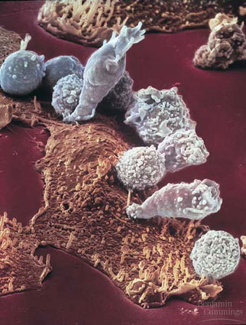
White Blood Cells
Leukocytes
Work to combat infection
Made both in the bone marrow and lymphoid tissue
Several types with various functions
Notes:
Liver and Kidneys are sensitive to the amount of oxygen that is delivered to them – if O2 levels drop the liver produces a globulin and kidney produces REF which combine to form erythropoietin which causes the red bone marrow to increase RBC production

Slide 8
Platelets
Very small cell fragments
Made in the bone marrow
Initiate blood clots
Thromobocytes
Platelets Damaged
thromboplastin
prothrombin
thrombin
Ca²⁺
fibrinogen
fibrin
Blood clot
Notes:
Liver and Kidneys are sensitive to the amount of oxygen that is delivered to them – if O2 levels drop the liver produces a globulin and kidney produces REF which combine to form erythropoietin which causes the red bone marrow to increase RBC production

Slide 9
Blood
Plasma
Red Blood Cells
White Blood Cells
Platelets

Slide 10
Our Goal Today...
Describe the components of blood.

