Slide 1
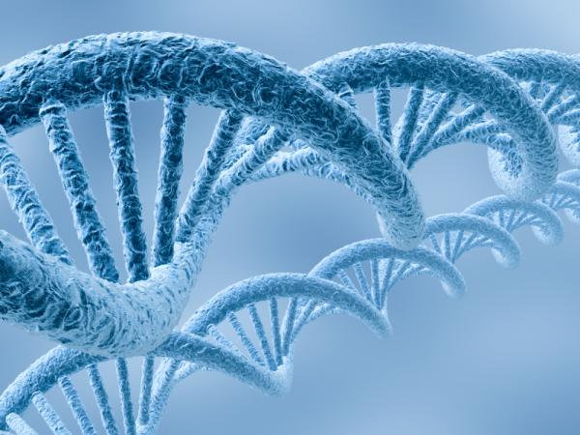
Deoxyribonucleic Acid
Structure
Function
Replication
Recombinant DNA
DNA versus RNA

Slide 2
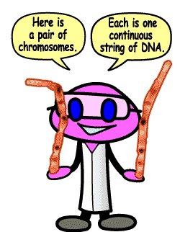
DNA
Biological Molecule: Nucleic Acid
Makes up Chromosomes
Discovered in 1953 by
Watson and Crick

Slide 3
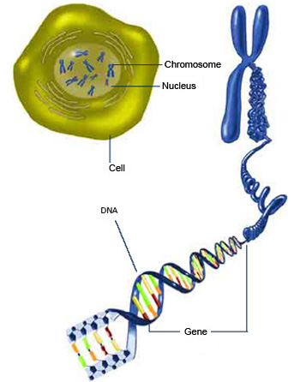
http://publications.nigms.nih.gov/thenewgenetics/chapter1.html

Slide 4
Nucleotide
STRUCTURE
Made up of DNA
Nucleotides:
Deoxyribose
(5 Carbon Sugar)
Phosphate
Base (G, C, A, T)

Slide 5
STRUCTURE
Sugar and Phosphate
Backbone
Double Stranded
Helix
http://evolution.berkeley.edu/evosite/history/dna2.shtml

Slide 6
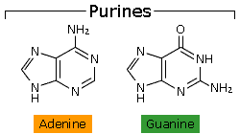
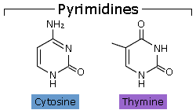
DNA Bases
Purines
Pyrimidines
Larger
Double Ringed
Adenine and Guanine
Smaller
Single Ring
Cytosine and Thymine
Bases bind complementary: C-G and A-T

Slide 7
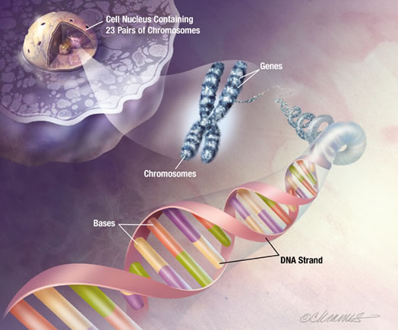
Functions of DNA
Replicate
Control Protein
Synthesis
Mutate

Slide 8
DNA Replication
To Copy Oneself
Must occur for the a cell to divide
Daughter cells have the exact DNA as parent cell
Part of Interphase of the cell cycle

Slide 9
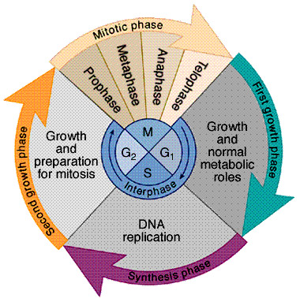
Cell Cycle

Slide 10
DNA Replication
DNA unzips (enzyme called DNA helicase breaks the hydrogen bonds)
New nucleotides bind to their complementary partners on the opened parts of the DNA (DNA polymerase)
New nucleotides bind together to form new strands of DNA (DNA polymerase)
When errors occur the results is mutation

Slide 11
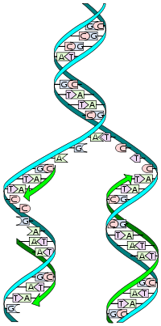
DNA Replication
Simplified Image:
Animations:
http://dna.microbiologyguide.com/526-biological-replication-dna-splitting/
http://www.stolaf.edu/people/giannini/flashanimat/molgenetics/dna-rna2.swf
http://www.youtube.com/watch?v=VJycRYBNtwY&feature=related

Slide 12
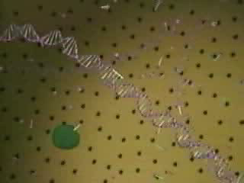

Slide 13
http://www.youtube.com/watch?v=dIZpb93NYlw

Slide 14
DNA versus RNA
Deoxyribose
Bases: A, T, G, C
Double Helix
Only in the nucleus
Ribose
Bases: A, U, G, C
Single Stranded
Present in the nucleus & cytoplasm

Slide 15
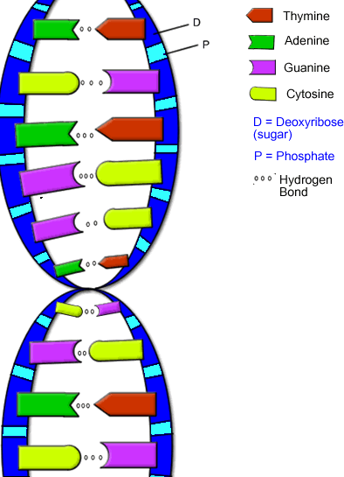
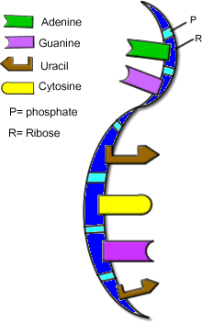
DNA versus RNA
DNA
RNA
http://www.biologycorner.com/bio2/genetics/notes_DNA.html

Slide 16
DNA
Structure and Function
DNA Replication
DNA versus RNA

