Slide 1
Digestive System Continued... The Digestive Tract

Slide 2
Remember Our Goals...
Analyse how the structures of the digestive system work together
Describe the components, pH, and digestive actions of salivary, gastric, pancreatic, and intestinal juices

Slide 3
The Digestive Process
Upper Digestive Tract
Stomach
Large Intestine
Small Intestine
Anus

Slide 4
Upper Digestive Tract
Physical Digestion: chewing by teeth
Chemical Digestion: enzymes
Salivary glands release saliva
Saliva contains water and an enzyme
Water = lubricant and reactant in hydrolysis reactions of digestion
Enzyme is _________________which breaks down starch into maltose

Slide 5
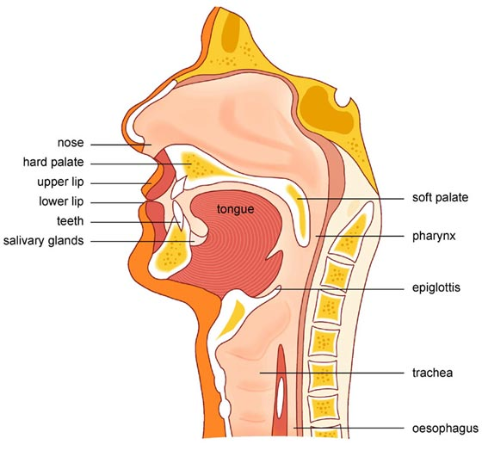
Upper Digestive Tract
http://164.109.68.222/en/images/Swallowing_Mechanism.jpg

Slide 6
Swallowing
Tongue forms a bolus for swallowing
___________ is food that has been rolled into swallowable round portions
Swallowing is a reflexive action in the muscles of the pharynx and esophagus

Slide 7
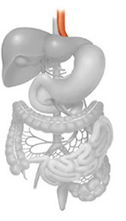
Upper Digestive Tract
Pharynx =
Carries both _________ and ____________(area where trachea and esophagus split)
______________ prevents food from going down the trachea
Peristalsis _________________
Cardiac sphincter is a constriction between __________________________which must relax before the bolus enters the __________________________

Slide 8
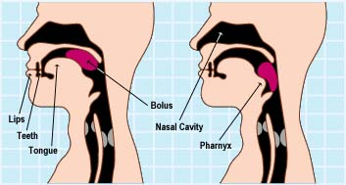
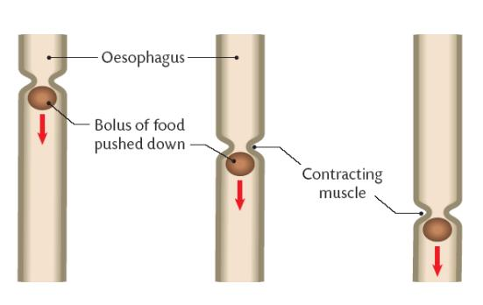
Swallowing and Peristalsis
http://www.oxygentimerelease.com/B/imagesb/q64swallow12.jpg
http://leavingbio.net/Human%20Nutrition/Human%20Nutrition_files/image018.jpg

Slide 9
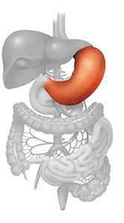
Stomach
Large J-shaped organ with 3 layers of muscle
Churn food materials
Food in stomach causes it to release gastrin (hormone)
Gastrin enters the blood and subsequently causes the stomach to secrete gastric juices
http://microbemagic.ucc.ie/inside_guts/stomach.html

Slide 10
Stomach – Gastric Juices
Contains ____________________________
Bolus becomes ________________ once exposed to gastric juice
_____ makes the pH of the stomach low (2.5) to kill any bacteria on the food
HCl also reacts with _______________ to form pepsin (a protease)
Stomach walls produce ______________ to protect the stomach from pepsin and the acid

Slide 11
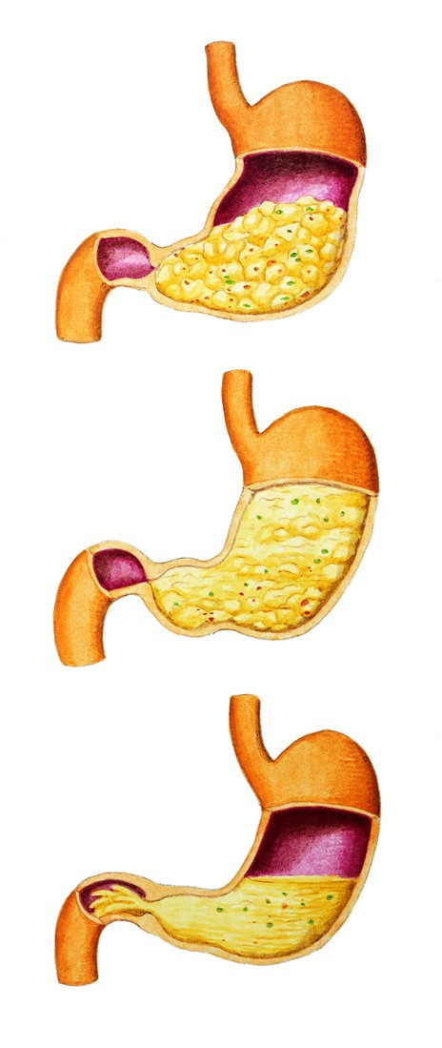
Small Intestine
______________________separates stomach and beginning of small intestine (duodenum)
Controls the amount of acid chyme entering the small intestine

Slide 12
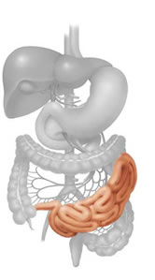
Small Intestine - Duodenum
Contains chemoreceptors are located in the duodenum that detect various biochemicals in the food
Acid chyme in the duodenum prompts it to release secretin (hormone)

Slide 13
Small Intestine
_______________ enters the blood stream where it causes the pancreas to release pancreatic juice
Pancreatic juice contains _____________
Bicarbonate ions (HCO₃⁻) change the pH of the acid chyme from around 2.5 to about 8.5 (alkaline)
Enzymes are active at a pH of _____

Slide 14
Small Intestine
CCK (Cholecystokinin)
Enzymes in Pancreatic Juice

Slide 15
Small Intestine – Intestinal Enzymes
Small intestine also produces its own enzymes
Maltase and other disaccharidases...
Peptidases __________________________
The digested food then moves into the last part of the small intestine called the _____________.

Slide 16
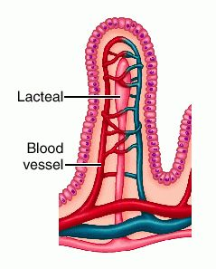
Small Intestine
Specialized for absorption
Huge surface area
Lined with villi which are special structures used for absorption
Villi have a lot of mitochondria to power the active transport required to move digested materials
Microvilli
Ileum
http://img.tfd.com/dorland/villus_villi-intestinales.jpg

Slide 17
Small Intestine
Most of the products of digestion enter the ______________________(simple sugars, amino acids, etc.)
Products of lipid digestion enter the ______________________through the lacteals
Ileum
http://img.tfd.com/dorland/villus_villi-intestinales.jpg

Slide 18
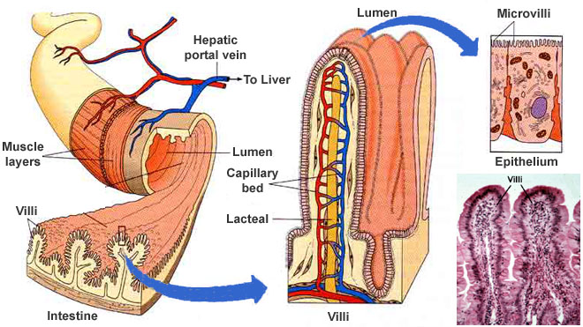
http://www.colorado.edu/intphys/Class/IPHY3430-200/image/villi.jpg

Slide 19
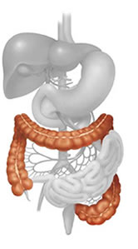
Large Intestine
Not everything can be absorbed (Ex. Cellulose)
Other materials are not absorbed in the small intestine (Ex. Water) or other materials not required by the body
Ileo-caecal valve is another sphincter between the ileum and the caecum (1st segment of colon)
Appendix is located just off of the caecum
AKA Colon

Slide 20
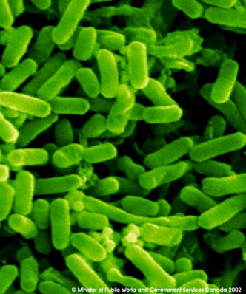
Large Intestine – E. coli
Absorb a large amount of water
Location of ___________ (anaerobic bacteria that breaks down some things our digestive system can’t)
E. coli lives symbiotically
E. coli begins the decomposition process that turns the waste into feces

Slide 21
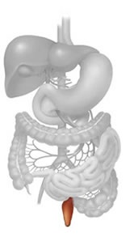
Anus
Feces is stored in the ___________ - the last segment of the colon
Defecation of the feces occurs through the __________________
Defecation

Slide 22
In Summary
Various enzymes work to metabolize food parts at specific pH and in specific regions of the digestive tract.
The digestive tract begins with the mouth and is a continuous tube ending in the anus (including accessory organs: liver and pancreas).
Food: the easiest thing you’ll “pass” in school!!!

Slide 23
Remember Our Goals...
Analyse how the structures of the digestive system work together
Describe the components, pH, and digestive actions of salivary, gastric, pancreatic, and intestinal juices

