Slide 1
Digestive Structures

Slide 2
Goals the Section...
Analyse how the structures of the digestive system work together
Describe the components, pH, and digestive actions of salivary, gastric, pancreatic, and intestinal juices

Slide 3
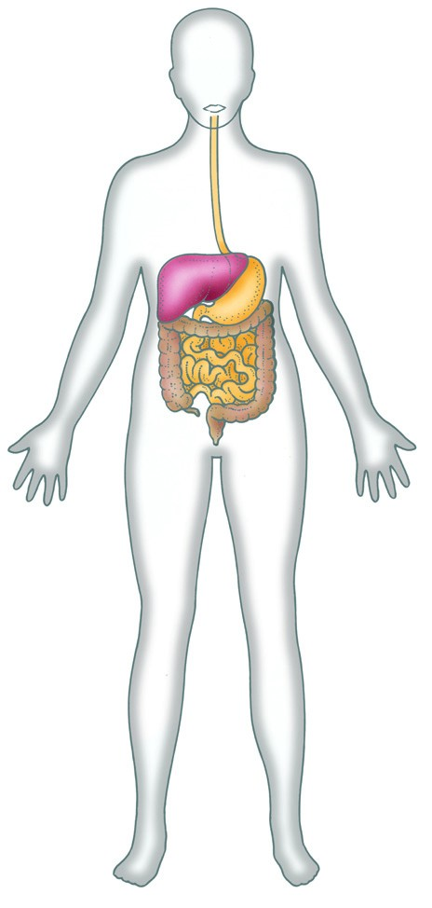
Digestive Structures
The 7m tube running from mouth to anus.
Location of food entrance, nutrient absorption
and waste excretion.

Slide 4
The Digestive System
Lets start with the accessory organs
Liver
Pancreas

Slide 5
Accessory Organs
Describe what it means to be an accessory organ in the digestive tract.
What are some examples?
Liver -
Pancreas -

Slide 6
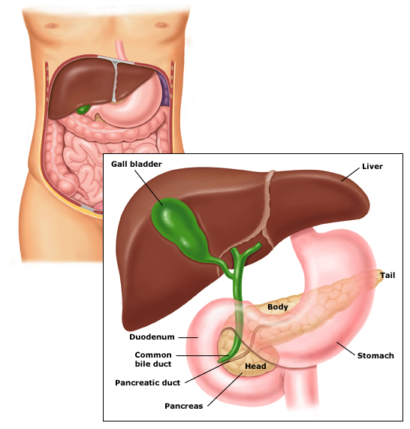
Liver and Pancreas
http://www.uptodate.com/online/content/images/gast_pix/Pancreas_anatomy.jpg

Slide 7
Pancreas
Posterior to stomach
Endocrine and Exocrine gland
Produces Pancreatic Juice, Insulin and Glucagon
Fill in the chart on the next slide… I have made a google doc!

Slide 8
Chart:
 | Pancreatic Juice | Insulin | Glucagon
Function
Cells of Pancreas
Endocrine or Exocrine?

Slide 9
Liver
Posterior to the diaphragm
Large
Generous blood supply
6 very important functions
Your Mission:
List the 6 functions of the liver in your “Liver and Pancreas google doc”

Slide 10
To Summarize Thus Far...
Enzymes play a crucial role in the digestion of food into absorbable unit molecules
Two accessory organs, the liver and pancreas, are provide life sustaining functions although they never directly process food
Next stop... The digestive tract!

Slide 11
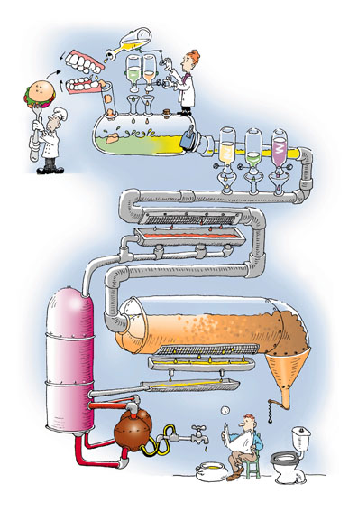
http://road-to-health.com/wordpress/wp-content/themes/thesis-15/rotator/digestion.jpg

