Slide 1
PORIFERA: Sponges
Porifera and Cnidarians

Slide 2
Porifera
The Sponges

Slide 3
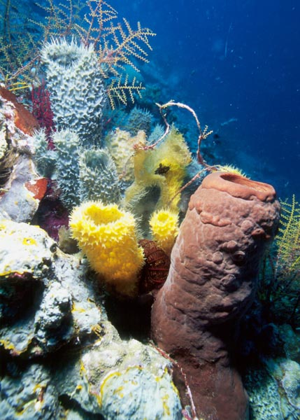
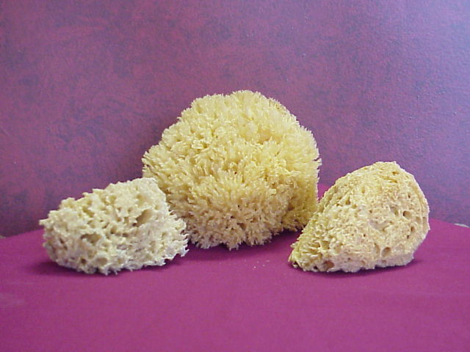

Slide 4
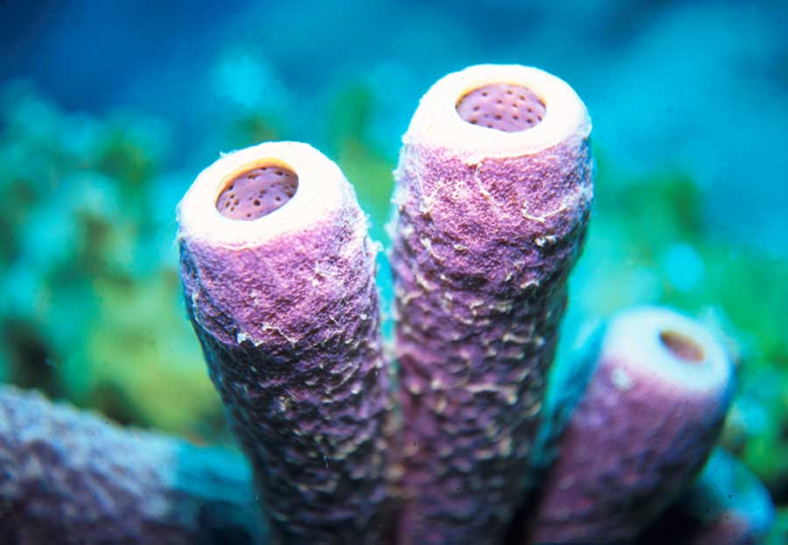
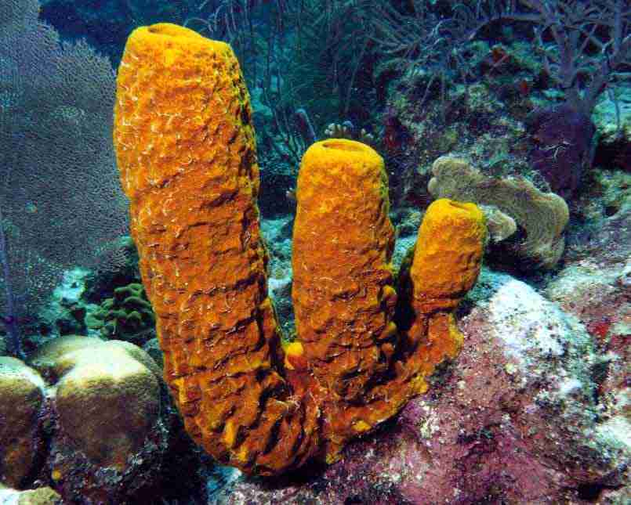

Slide 5
Porifera
Sac-like body plan
Radially symmetrical
Sessile
Hermaphroditic
Not cephalized (no head)
Attach to surfaces
Porifera means pore-bearing
Incurrent openings through which water enters the sponge – Porocytes
Excurrent opening or Osculum
Water exit

Slide 6
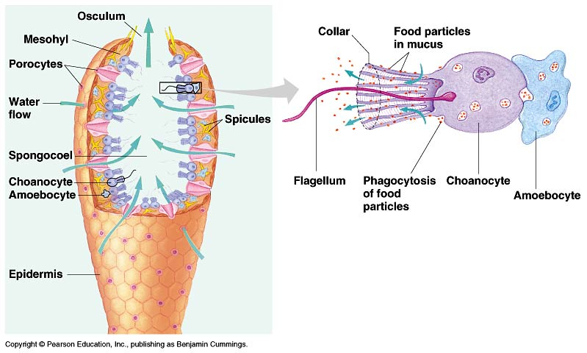
Porifera Structure

Slide 7
Porifera
Constant current of water moving through the sponge – created by the flagella of collar cells
New water enters the sponge with food & oxygen and leaves with wastes
No circulatory or respiratory systems – rely on diffusion
No specialized nervous system
Supported by spicules (hard) or spongeon fibers (soft)
Reproduction: hermaphroditic broadcasters, regeneration, gemmule formation

Slide 8
Cnidarians
Jellyfish, Hydra, Sea Anemones
http://www.youtube.com/watch?v=JoMCTvRkvxo&feature=fvw

Slide 9
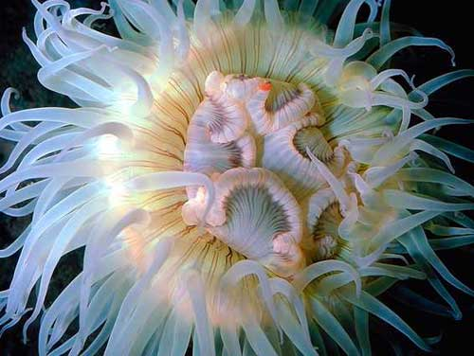
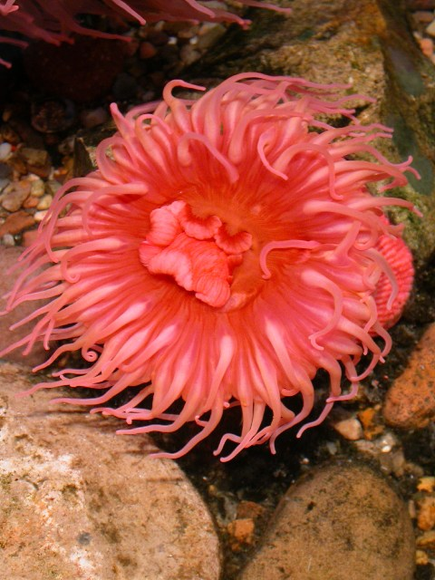
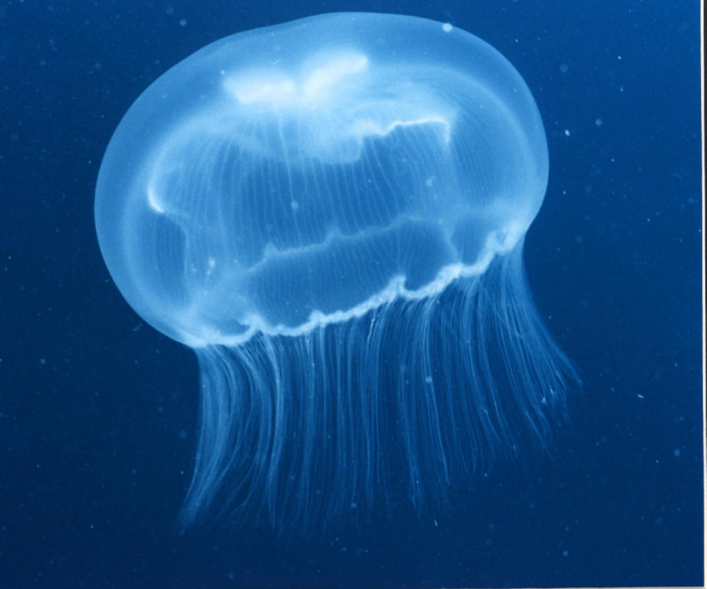
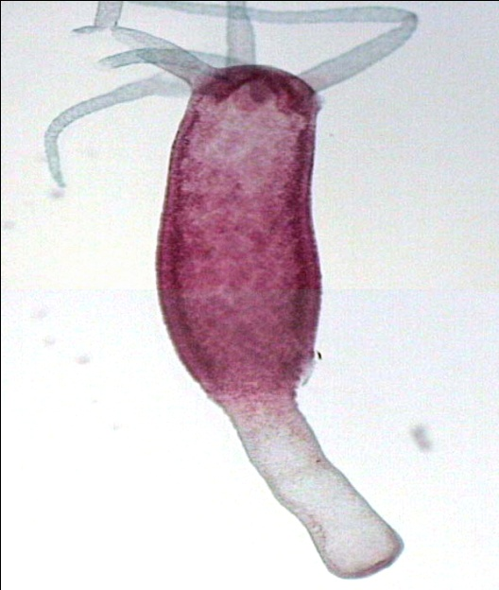
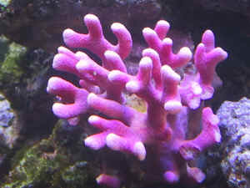
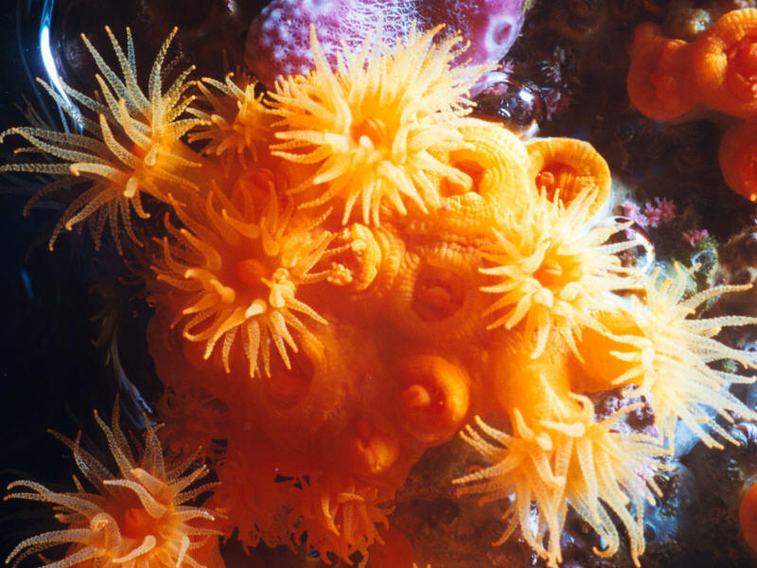
PHYLUM: Cnidaria

Slide 10
General Characteristics
“soft” bodied animals with tentacles surrounding mouth
Few cell layers thick
Radial symmetry
All have stinging cells call nematocysts (or cnidoblasts)
Sac-like body
Endoderm, Mesoglea, Ectoderm

Slide 11
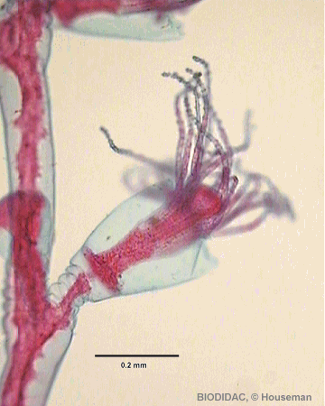
Cnidoblasts/Nematocysts
Each cnidoblast has a capsule called a nematocyst on the tentacle which contains a long coiled thread
When triggered, the nematocysts are discharged
Nematocysts are filled with poison and used to capture and eat prey
Some threads kill prey, others inject paralyzing toxins

Slide 12
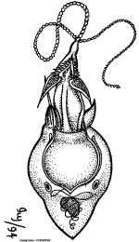
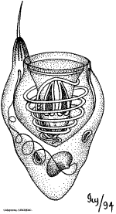

Slide 13
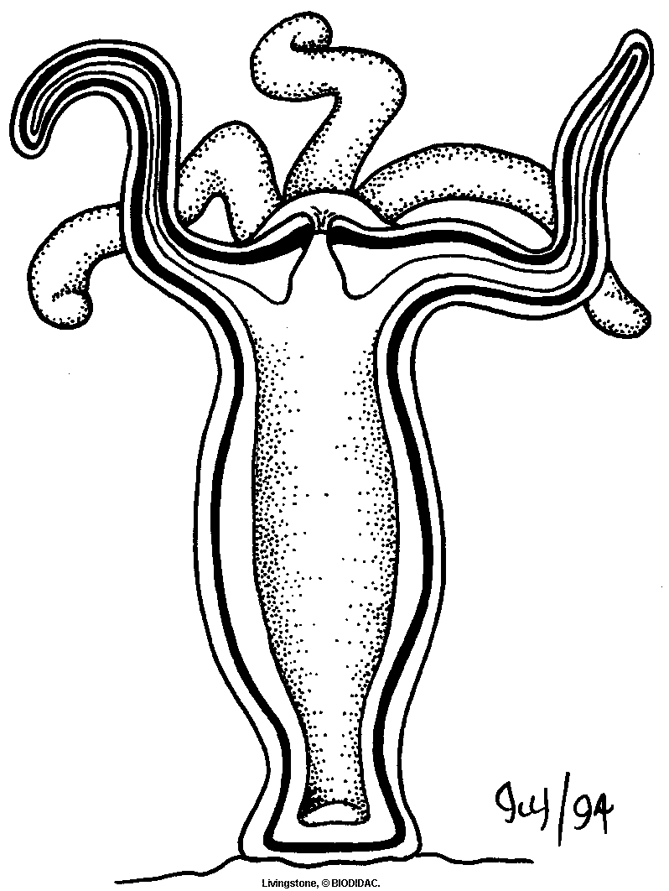
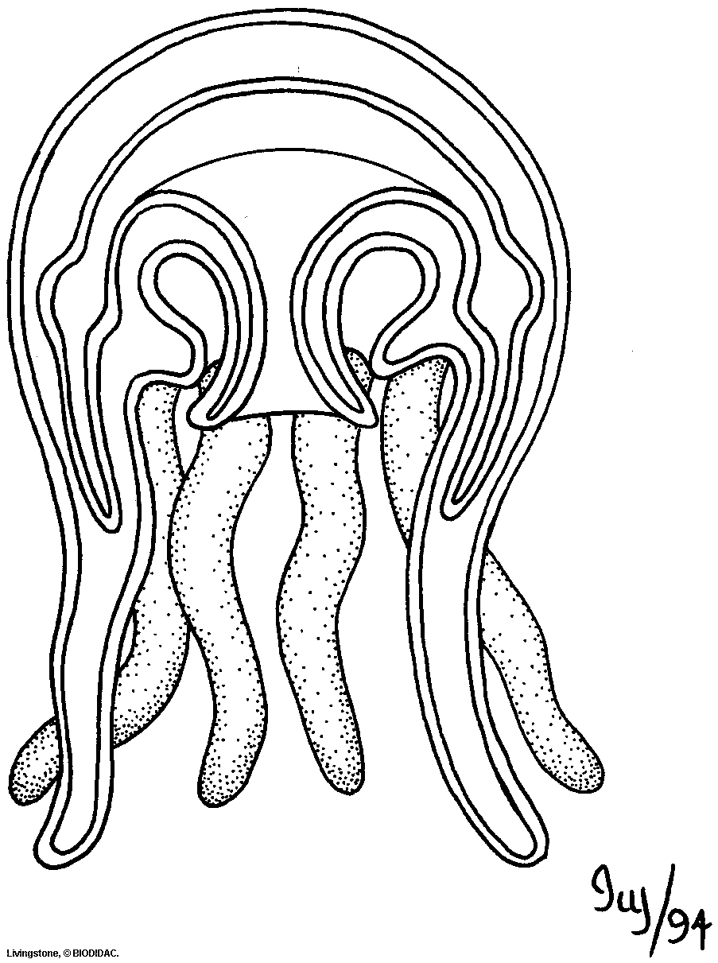
Body Forms
Polyp
Mouth at top
Sessile
Medusa
Mouth at bottom
Motile

Slide 14
In some species, one form is dominant, while the other is reduced (short-lived)
In other species, only one form is present and the other not present at all

Slide 15
Reproduction
Sexual and asexual
Medusa produces sperm and eggs into the water
If no medusa form is present (eg hydra) an ovary or testi develops in the polyp body wall
Asexual by fragmentation and budding (polyp)

Slide 16
Reproduction
Fertilization occurs in open water or inside an egg-carrying medusa
Zygote – ciliated larva that attach to a surface and become a polyp
Some are hermaphrodites, others are either male or female

Slide 17
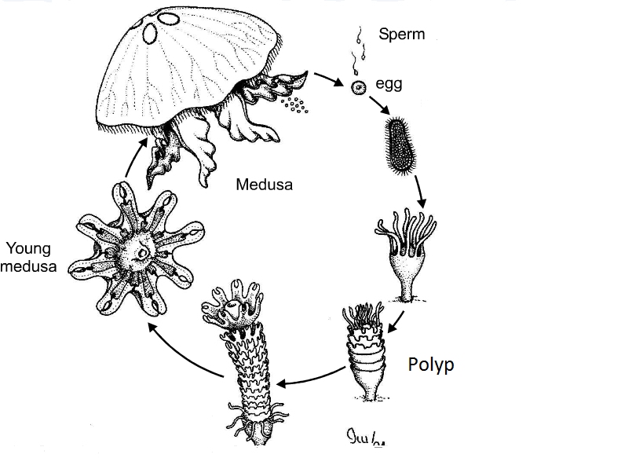

Slide 19
Movement
Lack muscle tissues that most animals have to move
Muscle fibres and nerve fibres are present
Cnidarians are capable of directional movement
The body can expand or shrink

Slide 20
Feeding
Tenticles that surround the mouth can reach out and grasp prey
Gastrovascular cavity carries out digestion and distributes food and gases
Nutrient molecules are passed by diffusion to other body cells

Slide 21
Response
No brain, but have a simple system – nerve nets
Sensory cells in the epidermal layer detect chemicals from food and touch for foreign objects

Slide 22
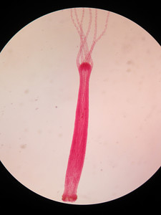
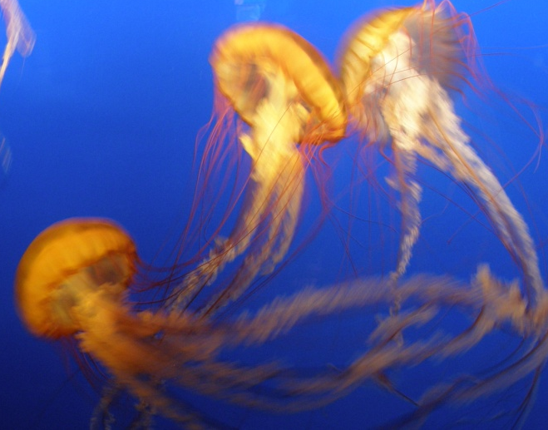
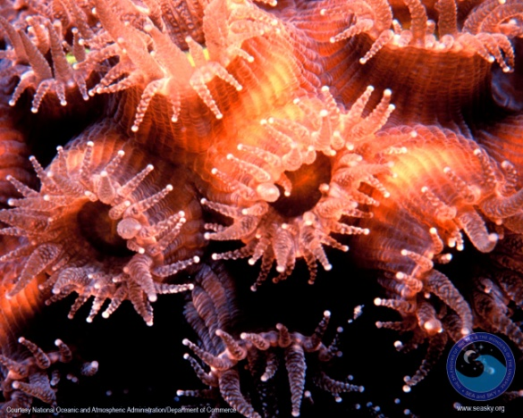
Classification
Hydrozoans
Exist mostly as polyp
Eg. Hydra
Schyphozoans
Exist mostly as medusa
Eg. Jellyfish
Anthozoans
Sessile polyps
Eg. Anemones, coral
forming cnidarians

