Slide 1
Protein Synthesis
How does DNA control all activities
of the cell from the nucleus?

Slide 2
DNA
Master molecule that controls all functions of the cell.
Restricted to the nucleus.
Proteins allow this to happen.
Here is an overview of how this occurs.

Slide 3
DNA
Transcription
A portion of DNA is copied by a molecule of RNA called messenger RNA (mRNA)
mRNA is able to leave the nucleus
Translation
mRNA delivers this message to a ribosome
At the ribosome another molecule called transfer RNA (tRNA) delivers specific amino acids
Amino acids are linked and eventually become a protein

Slide 4
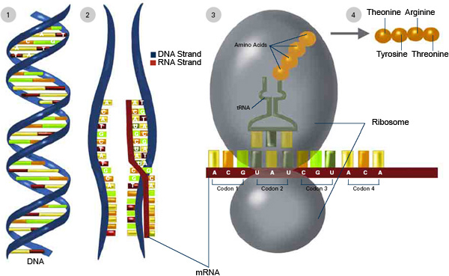
Protein Synthesis
http://publications.nigms.nih.gov/thenewgenetics/chapter1.html

Slide 5
mRNA
Transcription
Takes specific code from DNA in the nucleus to a ribosome.

Slide 6
mRNA
A gene (segment of DNA that codes for a specific protein) unwinds and unzips
Complementary bases align along the opened portion of DNA
mRNA bases A, U, G, C
Once the segment of mRNA is formed it breaks away from the DNA strand and leaves the nucleus
mRNA arrives at a ribosome

Slide 7
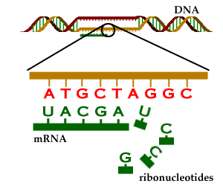
Transcription
mRNA message is created
http://genome.imim.es/courses/Madrid04/exercises/ensembl/

Slide 8
Codon Message
How do 4 bases code for 20 different amino acids?
If each base coded for an individual amino acid – that would only make 4 codes!
A 2 base code (eg. AU, AA, GU, etc.) would only allow for 16 codes!

Slide 9
Codon Message
RNA actually codes for amino acids in triplets – a possible 64 different combinations.
Eg. AUG (methione), GGA (glycine)
Some amino acids actually have more than one code!
Each segment of 3 bases on the mRNA is called a CODON

Slide 10
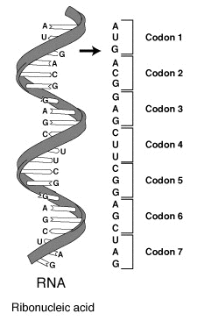
Codon Message
mRNA codons signal specific amino acids.
mRNA Codon | Amino Acid
AUG | Methionine/ START CODON
ACG | Threonine
GAG | Glutamic Acid
CUU | Leucine
CGG | Arginine
AGC | Serine
UAG | STOP CODON
http://commons.wikimedia.org/wiki/File:RNA-codons.png

Slide 11
Ribosome
Location of protein construction.
Remember ribosomes are either floating freely in the cytoplasm of the cell or are embedded in the walls of the rough endoplasmic reticulum.
Translation is the name of this second phase of protein synthesis.

Slide 12
Ribosome
Ribosomal RNA makes up the area of the ribosome where mRNA binds to the ribosome
The mRNA contains a series of codons (base triplets) that are complementary to the original DNA sequence
The first codon is AUG (methionine)
AUG is the codon that signals translation to begin therefore methionine is the first amino acid in any protein

Slide 13
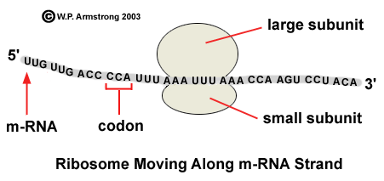
Translation
http://waynesword.palomar.edu/lmexer1a.htm#j
mRNA code moving along a ribosome

Slide 14
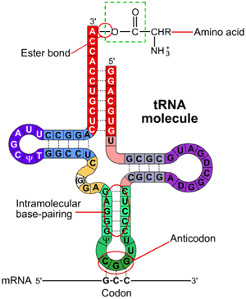
tRNA
A portion of the tRNA molecules reveals an anticodon
Each tRNA delivers an amino acid to the ribosome where it matches up to its complementary codon in the mRNA
Amino acids are linked together via peptide bonds
The result is a growing chain of amino acids
Once an amino acid is bound to the chain – it is removed from the tRNA
tRNA is then free to pick up another amino acid
Transfer RNA
Anticodon
Amino Acids
http://www.wiley.com/legacy/college/boyer/0470003790/structure/tRNA/trna_intro.htm

Slide 15
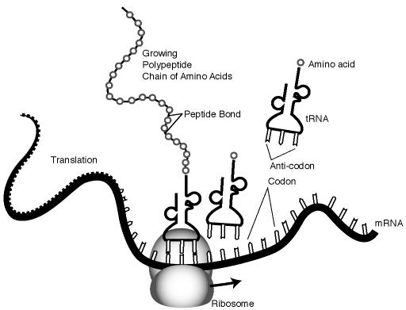
Translation
http://creationwiki.org/images/e/ed/Translation.JPG
mRNA code is translated at the ribosome where tRNA with complementary codes deliver amino acids

Slide 16
Terminator Codon
Signal ends protein synthesis.
The amino acid chain with continue to grow until a stop codon is reached
This codon is complementary to a tRNA that carries no amino acid therefore the process stops

Slide 17
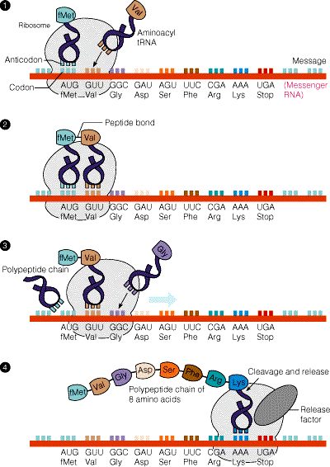

Slide 18
Final Steps...
All proteins have a purpose for the cell.
Secretory Proteins are packaged into vesicles and sent to the Golgi bodies for repackaging.
From the Golgi new vesicles transport proteins to the cell membrane for exocytosis.
Proteins produced on ribosomes in the cytoplasm tend to stay in the cell and are involved in cellular metabolism.
Proteins from ribosomes on the ER tend to be secreted.

Slide 19
Transcription
Translation
Protein!
DNA

Slide 20
Any when things go wrong... We have mutations!!!
A story better left for another time!

