Slide 1
Seed Plants
Gymnosperms & Angiosperms

Slide 2
What is a seed?
A seed contains an embryonic sporophyte
Has a protective coat and enough nutrients to support the sporophyte until it is ready to germinate
Seeds differ depending on their mode of species dispersal… eg. wind, animals, water etc.

Slide 3
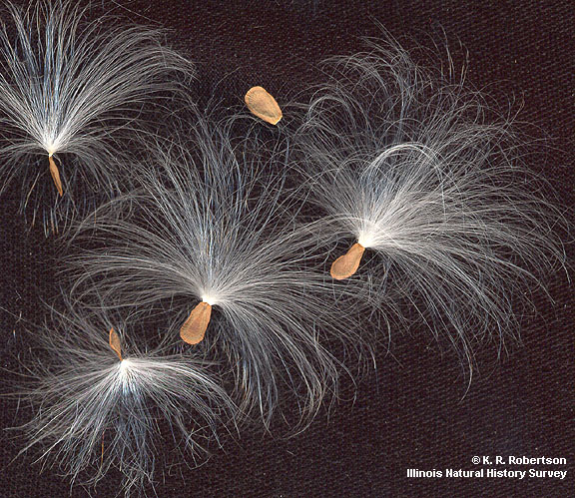
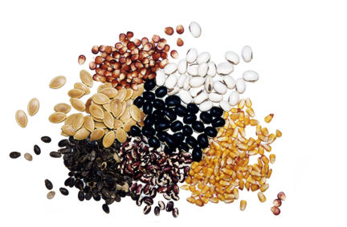
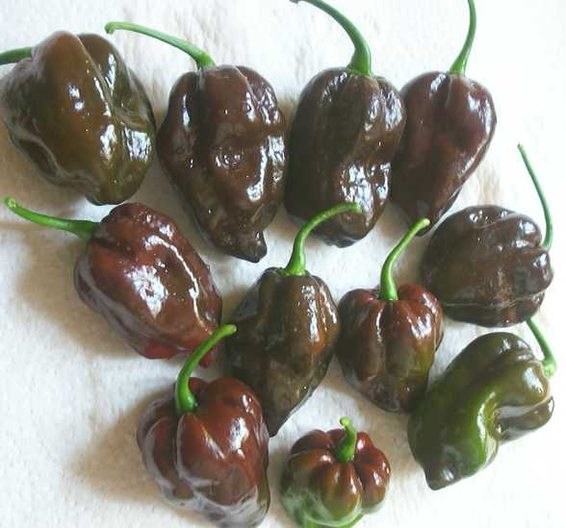
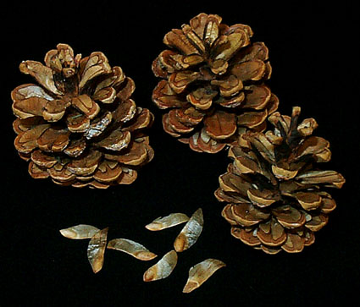
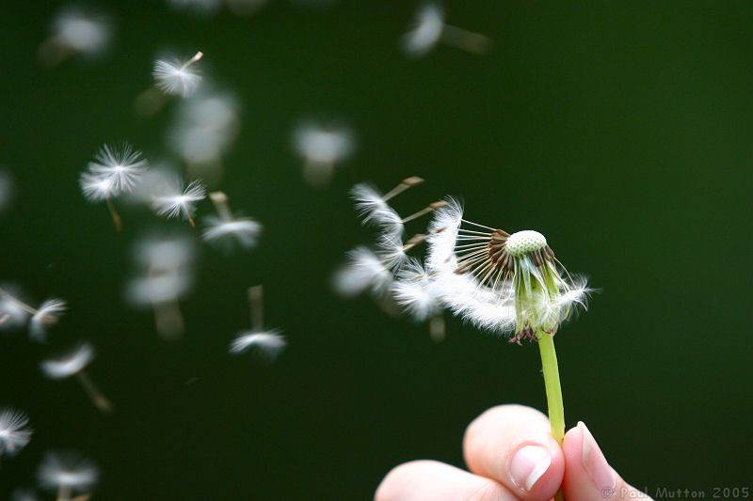

Slide 4
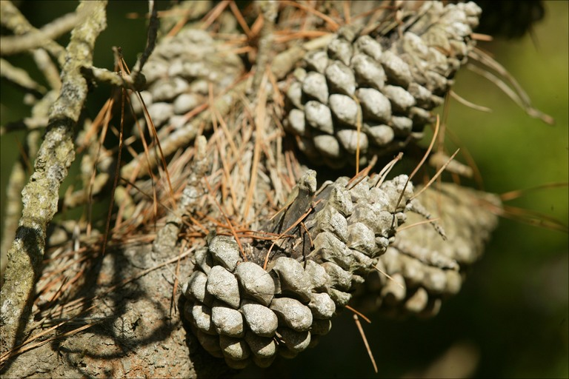
Gymnosperm = “naked Seed”
Seeds are uncovered or “naked”
They are often exposed on the surface of scales or cones

Slide 5
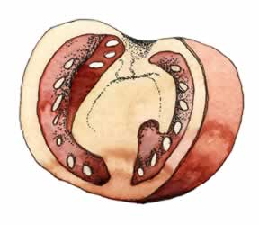
Angiosperm Seeds
How are angiosperms different from gymnosperm seeds?
Seeds are covered by a fruit

Slide 6
Seed Plant Life Cycle
Seed germinates into a sporophyte
Sporophyte produces megaspores and microspores by meiosis
Spores develop into megagametophytes and microgametophytes
Fertilization takes place
A seed is formed

Slide 7
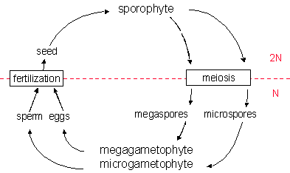
Seed Plant Life Cycle

Slide 8
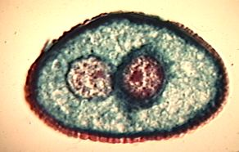
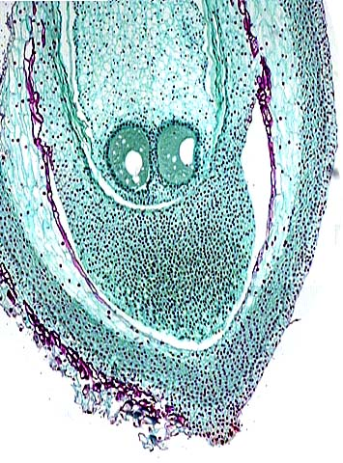
Two Types of Gametes
Microspores
Develops into a microgametophyte
In seed plants this is the POLLEN grain
Megaspores
Develops into a megagametophyte
In seed plants this is the EMBRYO sac

Slide 9
Gymnosperms

Slide 10
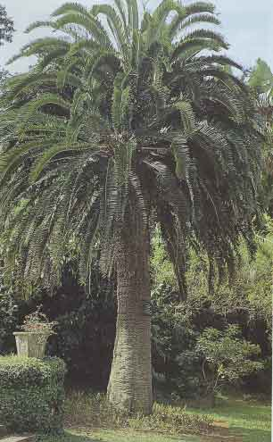
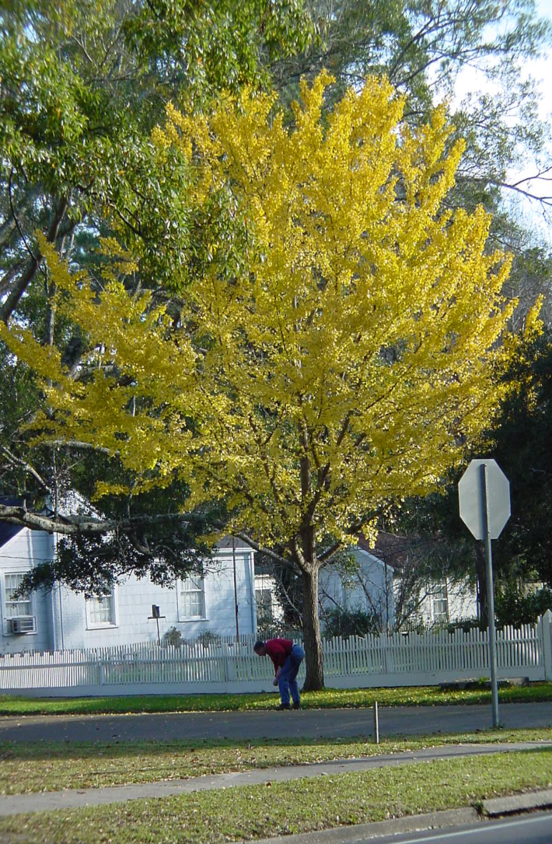
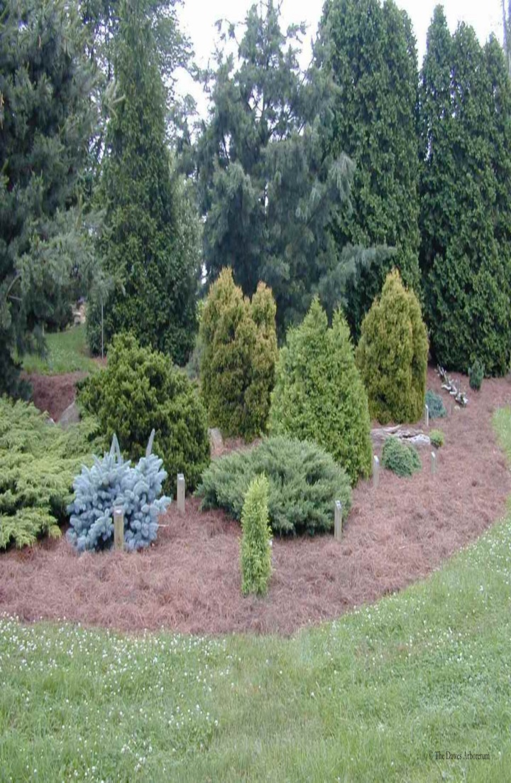
Gymnosperms
Includes: Cycads, Gingko, Conifers and Gnetophytes

Slide 11
Gymnosperms Adaptations to Land…..
Seeds → allow for species dispersal on land
Needles (or scales) → maintain water balance in dry cold climates
Vascular tissue → transport nutrients and water from surroundings throughout the plant (xylem and phloem)
Pollen → can be transported by wind, animals or insects for fertilization

Slide 12
Other Adaptations…..
Largest group of gymnosperms are the conifers (“evergreens”)
Needle / scale-like leaves which remain all year
Sporophyte (2N) generation is dominant
Cell wall is strengthened with lignin

Slide 13
Pollination and Fertilization
Pollination
• pollen grains are released from microsporangium in the male cones in spring
• pollen grain with its sperm nucleus is carried by the wind to the female cone
• pollen grains are captured on a sticky substance near the egg and ovule (female gametophyte)
Fertilization
• pollen grain land near ovule, forms a pollen tube that grows down into the ovule carrying the sperm nuclei of the pollen grain
• sperm nuclei fertilizes egg (N) zygote (2N)develops into a seed (2N)
• next year the seed (which contains the embryo, stored food, and a seed coat) is released from the female cone

Slide 14
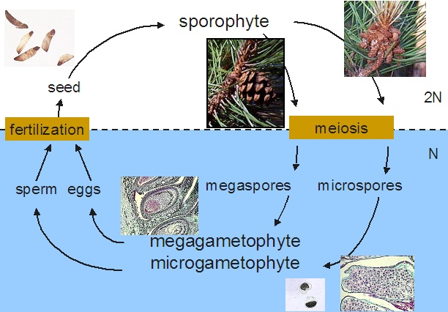
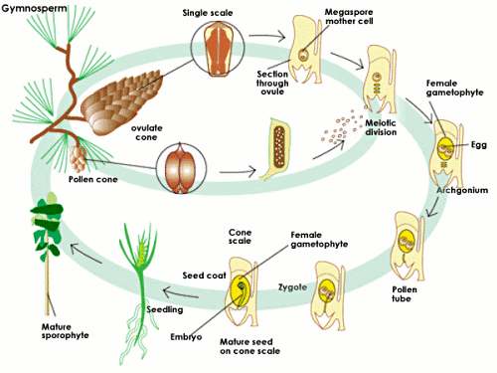
In Gymnosperms

Slide 15
Ecological Importance of Gymnosperms
Provide food and shelter for a variety of animals
Extensive roots prevent erosion by absorbing water
Maintain level of O₂ and CO₂ in the biosphere
Roots have mycorrhizae (mutualistic relationship) which help conifers obtain nutrients from the soil and fungi benefit with products of photosynthesis

Slide 16
Economic Importance of Gymnosperms
Pulp for paper and paper products
Lumber
Provide products such as turpentine and varnish
Medicines such as taxol from yew tree
Food source from seeds and stems, clothing from bark

Slide 17
For Tomorrow
Bring a gymnosperm sample in for tomorrow.
Complete the gymnosperm package.

Slide 18
Angiosperms

Slide 19
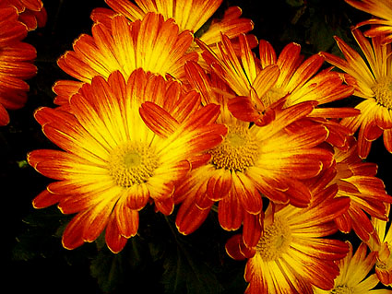
Angiosperms
An exceptionally large and successful group of plants
Includes:
All deciduous trees
All broad leafed evergreen
trees
All non-woody plants such as
grasses, garden plants,
flowering plants

Slide 20
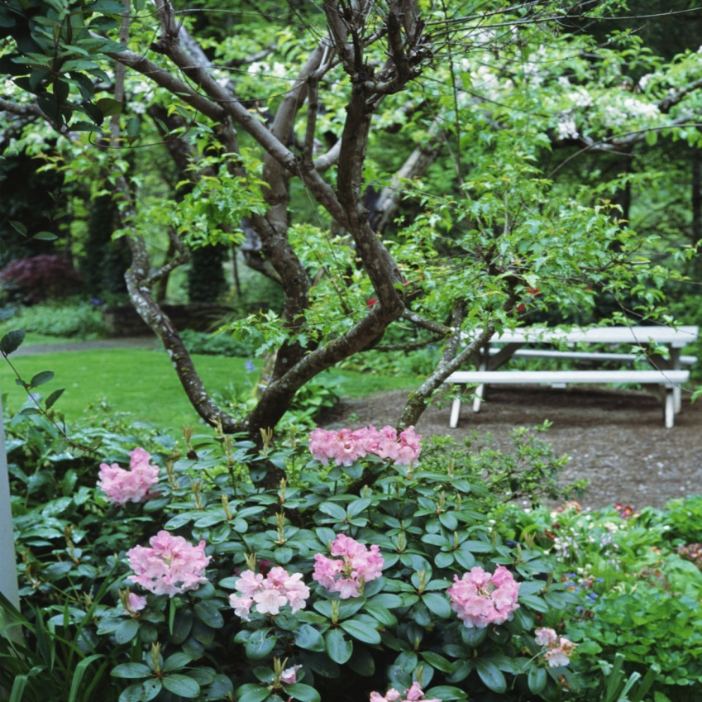
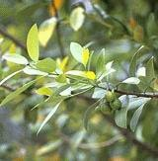
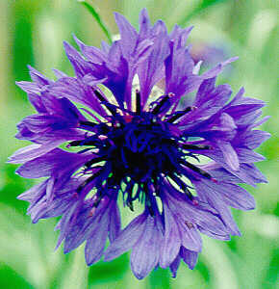
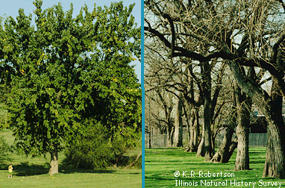
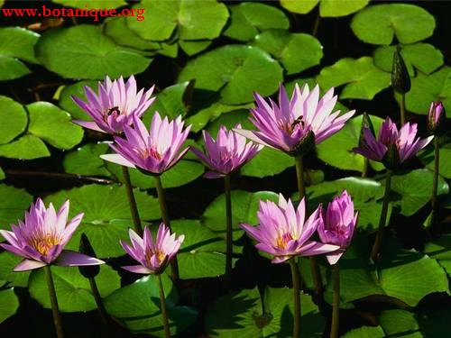
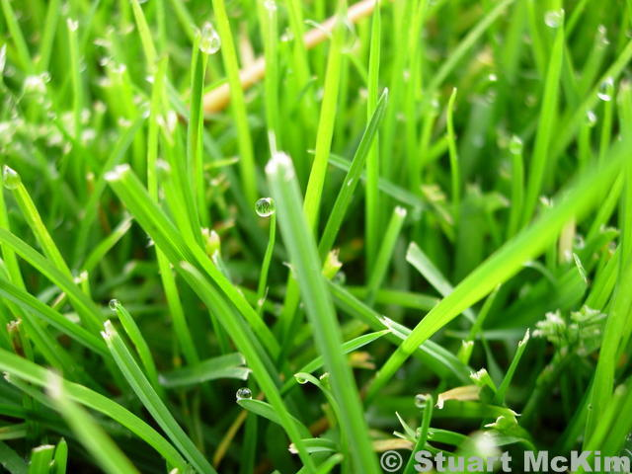
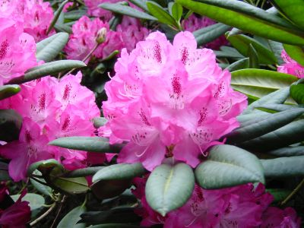
Some examples of angiosperms

Slide 21
Flower Structure
Microspores & megaspore are produced within flowers
Sepal
Green beneath the petals, protects the developing flower
Petals
Attract pollinators
Pistil
Vase like structurs in the centre of the flower, has 3 parts: stigma, style & ovary
Stigma is an enlarged, sticky knob at the top of the pistil (sticks to pollen)
Style is the stalk between the stigma and the ovary
Ovary is the enlarged base containing ovules
Stamens
Grouped around the pistil, has 2 parts: filament and the anther
Anther has 2 pollen sacs
Filament attaches the pollen sac to the flower

Slide 22
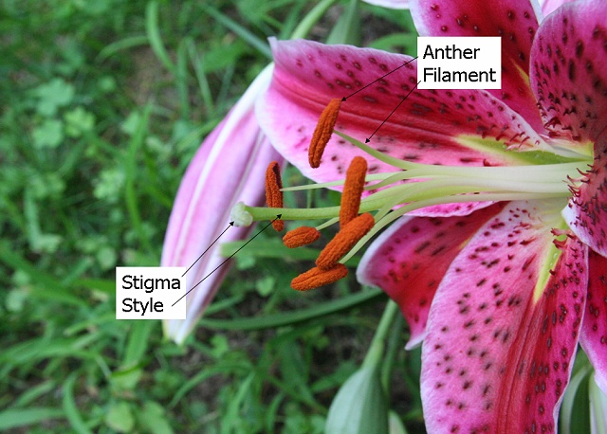
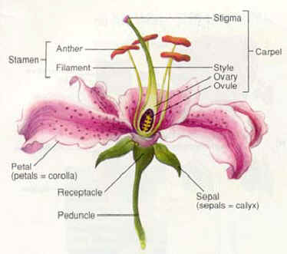
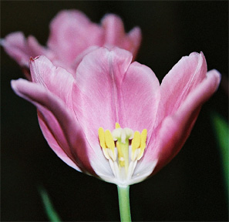
Flower Structure

Slide 23
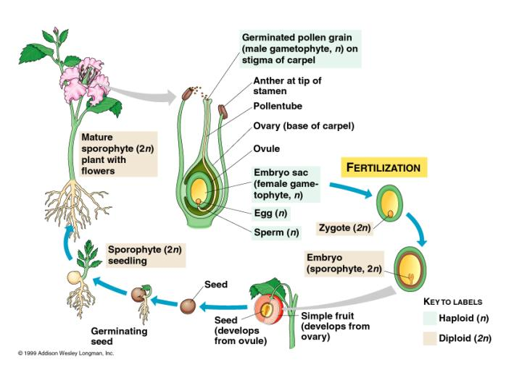
In Angiosperms

Slide 24
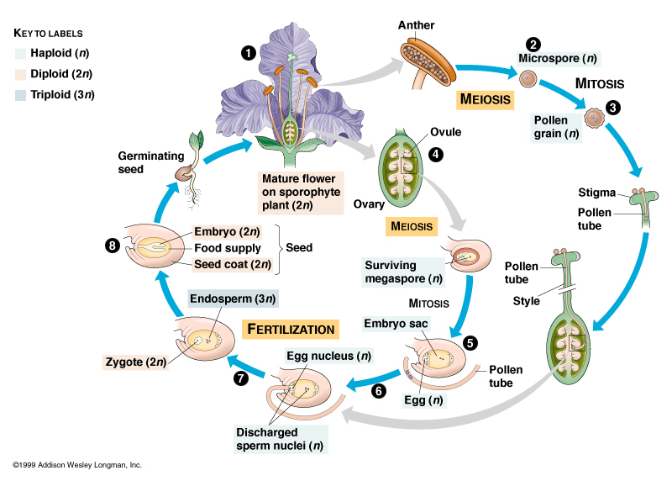

Slide 25
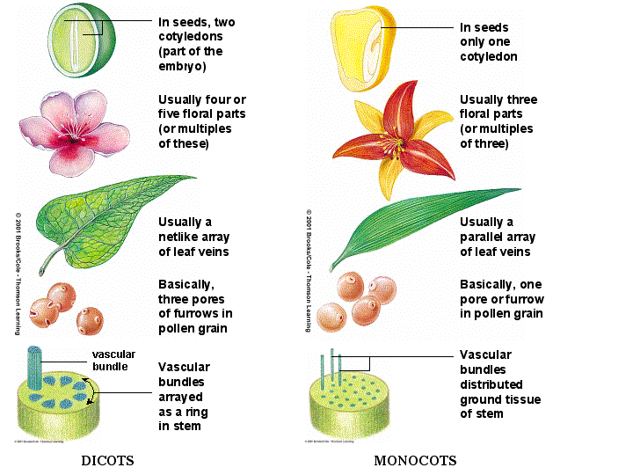
Two Groups of Angiosperms Dicotyldons & Monocotyldons

Slide 26
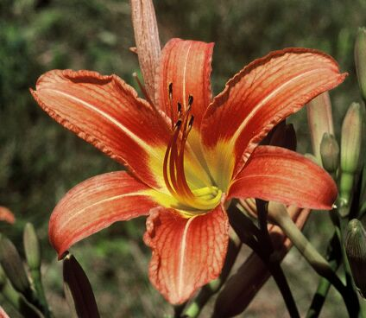
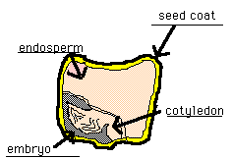
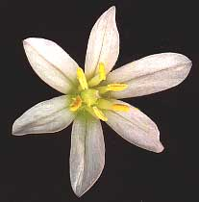
Monocots

Slide 27
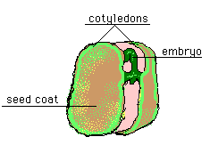
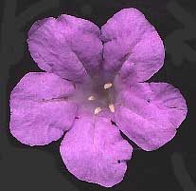
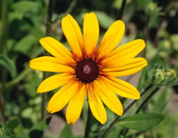
Dicots

Slide 28
Assignment
Prepare a summary chart comparing angiosperms and gymnosperms
 | Gymnosperms | Angiosperms
General Characteristics
Life Cycle and Reproductive Structures
Adaptations & Unique Characteristics
Examples & Classification

