Slide 1
Transport Across Membranes

Slide 2
Our Goal Today and Tomorrow...
Analyse the structure and function of the cell membrane

Slide 3
What We Already Know...

Slide 4
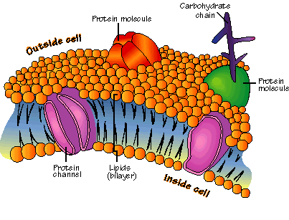
Cell Membrane
Phospholipid Bilayer

Slide 5
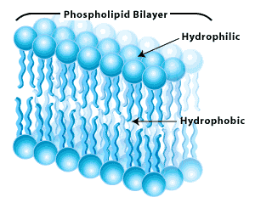
Phospholipid Bilayer
http://www.biologycorner.com/resources/lipidbilayer.gif

Slide 6
Phospholipid Bilayer
Outer surface is polar (phosphate groups)
Cells mix freely with polar molecules in their environment such as water
Middle of the layer are the fatty acids which are not water soluble

Slide 7
Proteins
Serve many functions in the cell membrane
Receptor Sites for molecules outside of the cell to attach to the cell (Ex. Hormones)
Protein Channels – areas for lipid insoluble molecules to enter the cell (Ex. Water)
Proteins thus contribute to the permeability of the cell
Differ from cell to cell

Slide 9
Carbohydrates
Glycolipids
carbohydrates attached to the phospholipids
Glycoproteins
carbohydrates attached to proteins
Label different types of cells (Ex. Antigens)
Plant cells do not have these carbohydrate chains
Differ from cell to cell

Slide 10
Carbohydrates
http://lamp.tu-graz.ac.at/~hadley/nanoscience/week4/membrane.jpg

Slide 11
Cholesterol
Inserts itself among phospholipids
Prevents the membrane from being too “fluid” but not too rigid
Decreases the membranes permeability to small water soluble molecules

Slide 12
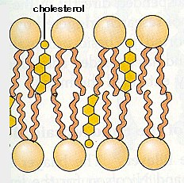
Cholesterol

Slide 13
Cell Membrane Properties
Selectively Permeable
Property of the membrane that allows it to select what materials move into and out of the cell
Cell can ensure some things do not enter the cell

Slide 14
Cell Membrane Properties
Fluid Mosaic Model
What is a mosaic?
What is a fluid?
Mosaic: there are many different types of proteins in the cell membrane
Fluid: electron microscopy revealed that these molecules can move through the bilayer

Slide 15
In Review
apply knowledge of organic molecules – including phospholipids, proteins, glycoproteins, glycolipids, carbohydrates, and cholesterol – to explain the structure and function of the fluid-mosaic membrane model
2) identify the hydrophobic and hydrophilic regions
of the phospholipid bilayer
3) explain why the cell membrane is described as
“selectively permeable”

Slide 16
Transport Across Membranes
Diffusion
Osmosis
Protein Assisted Transport
Vesicles

Slide 17
Diffusion
Passive process (requires no energy)
Driven by concentration differences
Rate of diffusion generally depends on:
Concentration
Solutions, Solvent, Solute
Concentration Gradient
Temperature
Shape and Size of Ion/Molecule
Ion Charge
Viscosity
Movement of Medium
Cytoplasmic Streaming
Notes:
No membrane required – perfume through a room.

Slide 18
Diffusion
A particle’s solubility and polarity also affect its ability to move through a cell membrane
Substances that move readily through membranes:
Small lipid soluble molecules
Non-polar gases
Notes:
No membrane required – perfume through a room.

Slide 19
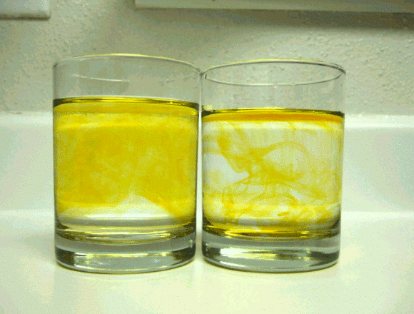
Diffusion
http://upload.wikimedia.org/wikipedia/commons/e/eb/Diffusion.gif

Slide 20
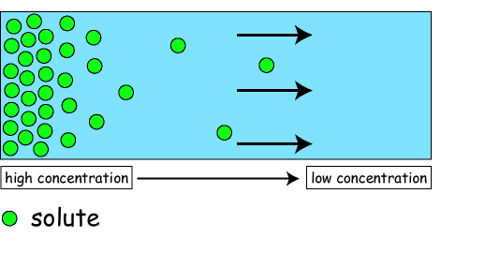
Diffusion
http://epswww.unm.edu/coursinf/eps462/graphics/diffusion.gif

Slide 21
Osmosis
Diffusion of water
In living things water is a solvent
Moves up the solute concentration gradient
Solute concentration evens out as it is diluted by water
Some molecules, larger molecules in particular, cannot pass easily through the membrane - water can move through the membrane to dilute its concentration

Slide 22
Osmosis
Terms to know:
Hypertonic
Hypotonic
Isotonic
Osmotic Pressure
Plasmolysis
Deplasmolysis
Crenated
Hemolysis
Turgidity
Turgor Pressure

Slide 23
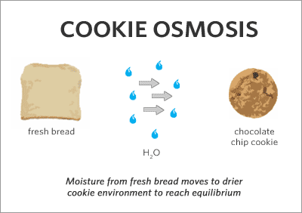
Osmosis
http://www.megnut.com/images/cookie_osmosis.gif

Slide 24
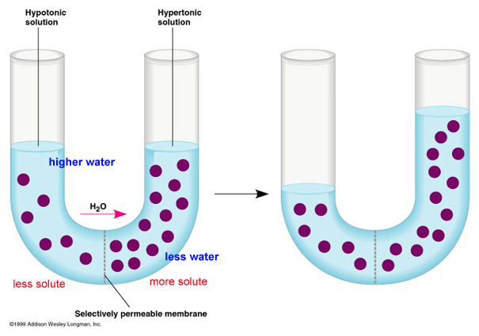
Osmosis
http://www.biologycorner.com/resources/osmosis.jpg

Slide 25
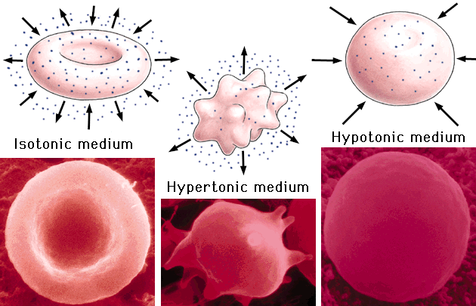
Osmosis in Red Blood Cells
https://www.msu.edu/~knickerk/webquest/osmosis2.gif

Slide 26
Remember Our Goal...
Analyse the structure and function of the cell membrane

Slide 27
Other Forms of Transport

Slide 28
Protein Assisted Transport
Proteins embedded in the membrane
Specific proteins carry specific solutes
Solute particle attaches to the protein causing the protein to change shape allowing the particle to move through the membrane (in or out)

Slide 29
Protein Assisted Transport
Two types of protein assisted transport:
Facilitated Transport (same laws as diffusion, no energy required)
Active Transport (move against the concentration gradient – requires energy)

Slide 30
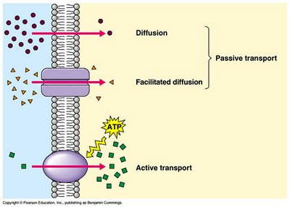
To Summarize thus Far...
http://2.bp.blogspot.com/_v2GFIISzHOU/R7lPf2YflUI/AAAAAAAAACk/-7hq4edM1TM/s400/Facilitated%2BTransport.jpg

Slide 31
Vesicles
Used for largest substances
Vesicles come into contact with the membrane, they fuse into it and open its surface releasing the contents of the vesicle either into the cell or outside of the cell
Exocytosis (materials released outside of cell)
Ex. Secretion of some hormones
Endocytosis (materials entering cell)
Ex. Phagocytosis

Slide 32
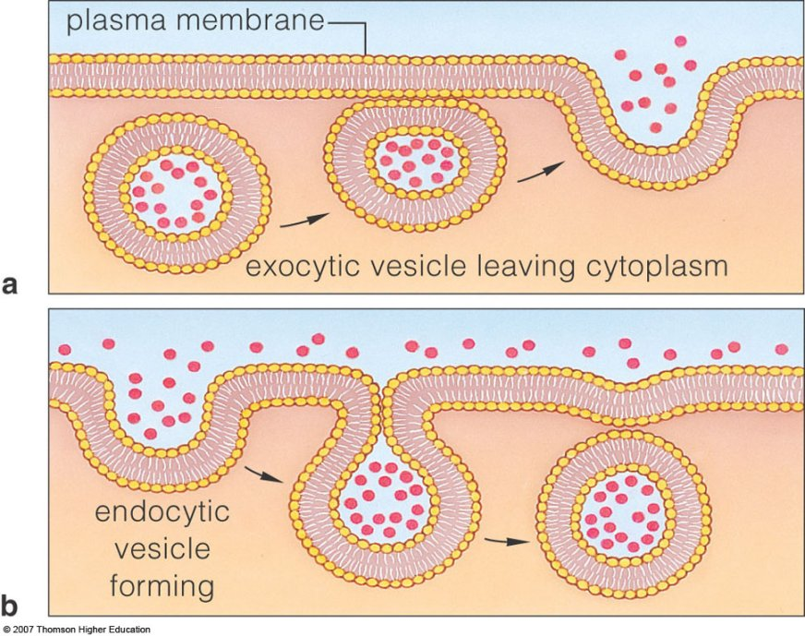
http://www.yellowtang.org/images/0322.jpg

Slide 33
Surface Area: Volume

Slide 34
Goal for this Final Section
Explain why cells divide when they reach a particular surface area-to-volume ratio

Slide 35
Surface Area/Volume Ratio
A cell’s size is very important for its survival
Materials entering and leaving a cell will alter its size
Environment can also change a cells size (Ex. Osmosis in a cell placed in distilled water)
Growth changes size of cell

Slide 36
Surface Area/Volume Ratio
Surface Area:Volume
This ratio is crucial to the balance of obtaining enough nutrients through its membrane and its ability to get rid of wastes
As a cell grows its volume increases faster than its surface area changing the ratio
If this ratio changes a cell can die, change shape or function or divide
However most specialized cells die if their SA:V is changed for too long

Slide 37
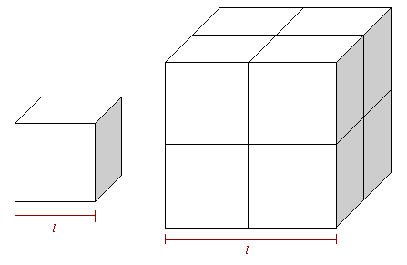
Single Cube (Small Cell)
Larger Cube (Bigger Cell)
Surface Area = 1 x 6 sides = 6
Volume = 1 x 1 x 1 = 1
SA:V = 6:1
Surface Area = 4 x 6 sides
Volume = 2 x 2 x 2 = 8
SA:V = 24:8 = 3:1
This cell will have larger nutrient needs but less area to get nutrients in!!

Slide 38
In Summary
Structure
The structure of the cell membrane is crucial to cell function.
Active & Passive Transport
Cells transport materials in and out using diffusion, osmosis, facilitated transport, active transport and endocytosis/exocytosis.
Surface Area: Volume
Cells rely on a specific surface area: volume ratio to function properly.

