Slide 1
UNIT 3 – SOLUBILITY EQUILIBRIUM
Unit 3/5

Slide 2
AN OVERVIEW OF SOLUBILITY

Slide 3
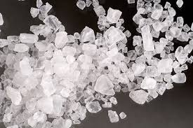
INTRODUCTION
This unit focuses on the solubility of IONIC solutions.
Note that both acids and bases are ionic, however we will only study the solubility of salts.
What are salts?
Provide 5 examples!

Slide 4
IONIC OR MOLECULAR?
Ionic: Compounds that form ions in solution
1) A metal and a non-metal will form ions in solution:
Ex. FeCl₃(s) → Fe³⁺(aq) + 3Cl⁻(aq)
2) A compound with polyatomic ions will form ions in solution:
Ex. (NH₄)₂SO₄(s) → 2NH₄⁺(aq) + SO₄⁻²(aq)

Slide 5
IONIC OR MOLECULAR?
Molecular: Do not form ions in solution (covalent)
1) A non-metal and a nonmetal
Ex. CH₃OH(l) → CH₃OH(aq)
2) Exceptions: Organic Ions like acetate (CH₃COO⁻) form ionic solutions
(See page 73-74)

Slide 6
DISSOCIATION OF IONS
1) Electrolyte – a substance which can conduct electricity because it contains ions. Produced by dissolving an ionic salt.
2) Nonelectrolyte – a substance which dissolves to give an electrically non-conducting solution. Produced from molecules.
Therefore: NO IONS = NO CONDUCTIVITY

Slide 7
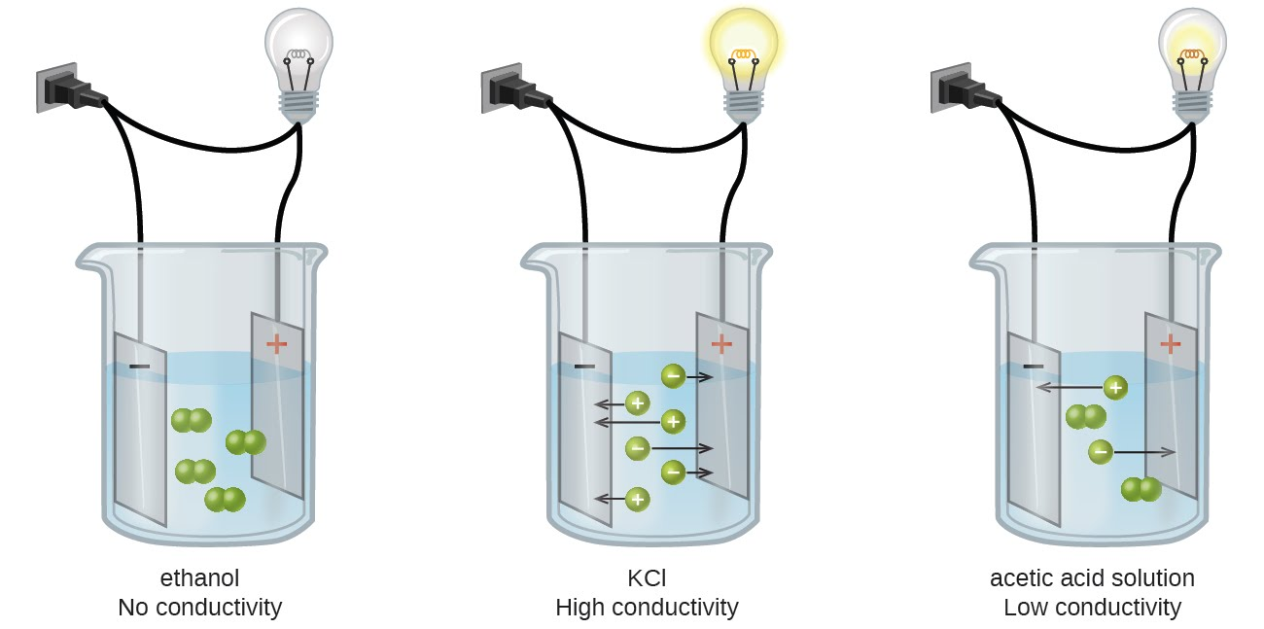

Slide 8
PRACTICE
Try exercises #1 and 2 on page 74 of your textbook!

Slide 9
SATURATED SOLUTION
In Chemistry 11 we said this was the maximum amount of substance that can dissolve in a given amount of solvent at a particular temperature.
Chemistry 12
1) At EQUILIBRIUM – the dissolved substance is in equilibrium with the undissolved substance.
2) The solubility of a substance is the equilibrium concentration of the substance in a solution at a given temperature.
3) Saturation exists if:
Some undissolved material is present
Equilibrium exists between the dissolved and the undissolved material

Slide 10
SOLUBILITY
The equilibrium concentration of a solute in a particular solvent at a certain temperature.
Common units: mol/L (M), g/L (amount/volume)

Slide 11
EQUATIONS
Solubility Equilibrium:
AgBrO₃(s) ↔ Ag⁺(aq) + BrO₃⁻(aq)
Your equilibrium equations for this unit will always be written in this format. The next two slides will explain.

Slide 12
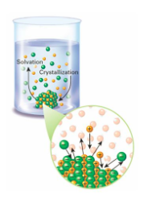
SOLUBILITY EQUILIBRIUM
The equilibrium: AgBrO₃(s) ↔ Ag⁺(aq) + BrO₃⁻(aq)
Is the equilibrium between the dissolving reaction
(salt to ions)
AgBrO₃(s) →Ag⁺(aq) + BrO₃⁻(aq)
And the crystallization reaction (ions to salt)
Ag⁺(aq) + BrO₃⁻(aq) → AgBrO₃(s)

Slide 13
AgBrO₃(s) ↔ Ag⁺(aq) + BrO₃⁻(aq)
Just like in unit 2… equilibrium is when the rate of the forward reaction is equal to the rate of the reverse reaction.
Write this in terms of solubility:

Slide 14
YOUR TURN
1) Complete exercises #3-7 (pg 76)
2) Read page 77
3) Start reviewing dissociation equations and calculating ion concentrations.

Slide 15
CALCULATING SOLUBILITY

Slide 16
TRY THESE:
1) It is found experimentally that 1L of saturated AgBrO₃(aq) contains 1.96g of AgBrO₃. What is its solubility in M (mol/L)
2) If the solubility of lead (II) iodide is 1.37 x 10⁻³M, what is its solubility in g/L?
3) If 250mL of a saturated solution of CaCl₂ contains 18.6g at 20˚C. What is its solubility in M (mol/L)

Slide 17
INDIVIDUAL IONS
When given a salt, it is important to dissociate into its positive and negative ions and ensure to balance.
Ex. Na₂SO₄(s)↔ 2Na⁺(aq) + SO₄²⁻ (aq)
Use this equilibrium to answer the following questions:
If [Na₂SO_{4(s)}] is 0.12M, what is [Na⁺_{(aq)}]? [SO₄²⁻ _{(aq)}]?
If [Na⁺_{(aq)}] is 0.89M what is [Na₂SO_{4(s)}]?

Slide 18
YOUR TURN…
What is the concentration of all ions present in a saturated solution of silver carbonate having a concentration of 1.2 x 10⁻⁴M?

Slide 19
DILUTION
Remember the formula? Good, write it here!
Calculate the concentration of all the ions present when 23.0mL of 0.135M MgCl₂(aq) is added to 15.0mL of 0.250M LiCl(aq).

Slide 20
HOMEWORK
1) Read page 81-83
2) Complete exercises #8-20
3) Entrance question tomorrow?!

Slide 21
THE SOLUBILITY TABLE!
Find this in your data booklet or the back of your book.

Slide 22
WILL A SUBSTANCE DISSOLVE IN WATER?
1) Soluble
If more than 0.1mol of a substance dissolves in 1 litre of water – this substance is considered.
2) Low Solubility
A saturated solution of the substance is less that 0.1M.
Nothing is totally INSOLUBLE – although they can exhibit negligible solubility.

Slide 23
SOLUBILITY OF COMMON COMPOUNDS IN WATER
This helps us determine how a compound will behave at 25˚C.
Use the chart to determine whether a substance will dissolve in water or stay as a solid. Note that is table can also be used to determine whether a precipitate will form!
Do the following compounds have low solubility?
AgI
BaSO4
BaS
NH₄Cl

Slide 24
TRY THESE:
Which if the following would form a saturated solution when 0.010mol of the solid solute is added to 100mL of water?
A. BaCO₃
B. FeSO₄
C. NaCN
D. Pb(NO₃)₂
What precipitates form when equal volumes of 0.3M AgNO₃, 0.3M SrCl₂, and 0.3M Na₂CO₃ are mixed together?

Slide 25
HOMEWORK
Exercises 21-24
Read pages 84-87
Exercise 25

