Slide 1
Unit 4- Acid Base Chemistry

Slide 2
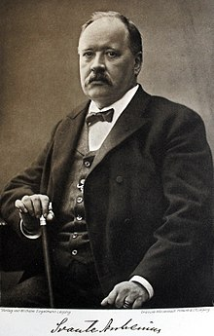
Arrhenius Theory of Acids and Bases
This is the theory that you have been taught thus far:
1) Acids release H+(aq) in water
2) Bases release OH-(aq) in water
3) Salts form as the result of and acid base neutralization

Slide 3
Acids
H+ in water allow for the following properties:
React with bases
Are Electrolytes
Will react with some metals to produce hydrogen gas:
HCl(aq) + Mg → H₂(g) + MgCl₂(aq)
Turn litmus paper RED
Taste sour (think citrus fruit and vinegar!)
Strong Acid = any ionic compound that starts with an “H”
Ex. HCl (hydrochloric acid), HNO₃ (nitric acid)

Slide 4
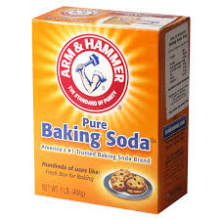
Bases
The presence of OH in solution gives bases the following properties:
react with acids
are electrolytes
feels slippery
turns litmus paper blue
taste bitter

Slide 5
Homework
Read page 109 -114
Complete exercises 1-9 of unit 4.
Complete worksheet on “Common Acids and Bases”

Slide 6
True Nature of H+

Slide 7
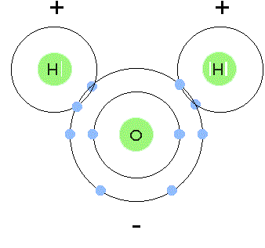
H⁺ (aq) – Just a Proton
Hydrogen atom is only one proton surrounded by one electron.
It we removed the electron – it becomes H+ which is simply an “naked” proton.
This means there is a concentration of positive charge which is strongly attracted to an region where negative charge exists… enter water:
These non bonded electrons are very attractive to H ions!

Slide 8
So…. What happens?
All the Hydrogen ions attach to water molecules:

Slide 9
The Hydronium IOn
What we have been previously calling H⁺_{(aq)} we will now call H₃O ⁺_{(aq)}
When we ionize acids we will now show hydronium ions.
So we would previously write this:
HCl(g) → H⁺(aq) + Cl⁻(aq)
Now it would be:
HCl(g) + H₂O(l)→ H₃O⁺(aq) + Cl⁻(aq)

Slide 10
Homework
Read page 115 and complete exercise 10.

Slide 11
The Bronsted-Lowry Theory
A modification the Arrhenius theory to allow for equilibrium!
This also means that we also have a broader definition of what acids and bases are.
Bronsted-Lowry Theory:
An Acid is a substance which DONATES A PROTON to another substance
A base is a substance that ACCEPTS A PROTON from another substance

Slide 12
The Bronsted-Lowry Theory
Examples:
Notice that there is an acid and a base on each side of the equilibrium and never two acids on one side!

Slide 13
Definitions
Find the meaning and an example of each of the following terms:
Monoprotic Acid
Diprotic Acid
Triprotic Acid
Polyprotic Acid
Amphiprotic

Slide 14
Homework
Read pages 115-119
Complete exercises 11-15

